Slide 1

EE930 - Detection for Wireless
eMasters – Q2-2023-24
IIT Kanpur
Venkateswar Reddy Melachervu
CTO
24th Sept 2023
Brillium Technologies
#501, C Block, Salarpuria Serenity, 5th Main, Sector 7, HSR Layout, Bengaluru 560102, Karnataka, India
Website: www.brillium.in | Email: connect@brillium.in

Slide 2
Detection
Evaluation of the performance of a detector depends upon the ability to determine the probability density function of a function a function of the data samples – either analytically or numerically
When it is NOT possible to determine the PDF, we must resort to Monte Carlo computer simulation techniques
Familiarity with common PDFs and their properties is essential to the success of the Performance Evaluation
  Gaussian/Normal Distribution – Gaussian/Normal PDF
  Chi-Squared (Central and Non-central) Distributions – Chi-Squared PDFs
  F (Central and Nopn-central) Distribution – F (Central and Non-central) PDFs
  Rayleigh Distribution and Rayleigh PDF
  Rician Distribution and Rician PDF
Design of detectors of signal in/with noise is based on statistical decision theory
In particular, a simple hypothesis testing framework is employed in which the PDF for each assumed hypothesis is completely known
A much more complicated problem arises when the PDF has unknown parameters
The primary approaches to simple hypothesis testing are:
  Classical approaches based on Neyman-Pearson theorem
  Bayesian approach based on minimization of the Bayes risk
In many ways these approaches are analogous to the classical and Bayesian methods of statistical estimation theory
A particular method employed depends upon our willingness to incorporate prior knowledge about the probabilities of occurrence of the various hypotheses
SONAR and RADAR systems typically use Neyman-Pearson criterion while communication and pattern recognition systems employ the Bayes Risk

Slide 3
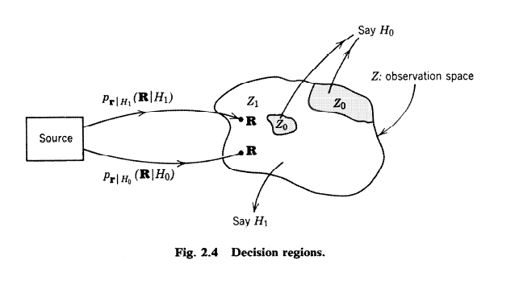
Decision Regions

Slide 4
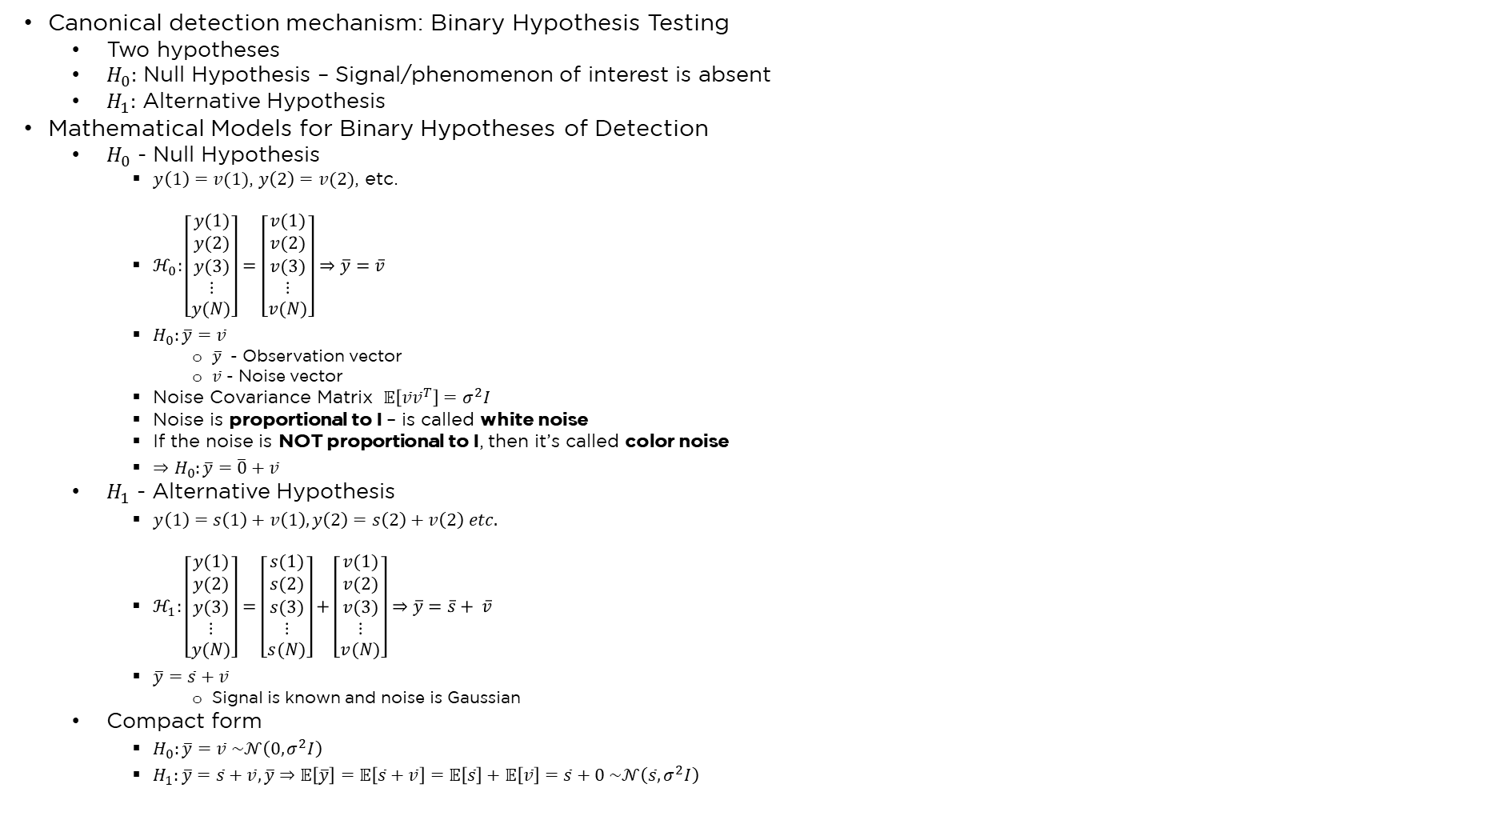
Likelihood Ratio Test for Detection - LRT
Canonical detection mechanism: Binary Hypothesis Testing
  Two hypotheses
  $H_{0}:$ Null Hypothesis – Signal/phenomenon of interest is absent
  $H_{1}:$ Alternative Hypothesis
Mathematical Models for Binary Hypotheses of Detection
  $H_{0}$ - Null Hypothesis
    $y\left(1\right)=v(1)$, $y\left(2\right)=v(2)$, etc.
    $ℋ_{0}:\left[\begin{matrix}y(1) \\ y(2) \\ \begin{aligned}y(3) \\ ⋮ \\ y(N)\end{aligned}\end{matrix}\right]=\left[\begin{matrix}v(1) \\ v(2) \\ \begin{aligned}v(3) \\ ⋮ \\ v(N)\end{aligned}\end{matrix}\right]⇒\overline{y}=\overline{v}$
    $H_{0}:\overline{y}=\overline{v}$
      $\overline{y}$ - Observation vector
      $\overline{v}$ - Noise vector
    Noise Covariance Matrix $𝔼\left[\overline{v}{\overline{v}}^{T}\right]=σ^{2}I$
    Noise is proportional to I – is called white noise
    If the noise is NOT proportional to I, then it’s called color noise
    $⇒H_{0}:\overline{y}=\overline{0}+\overline{v}$
  $H_{1}$ - Alternative Hypothesis
    $y\left(1\right)=s\left(1\right)+v\left(1\right), y\left(2\right)=s\left(2\right)+v\left(2\right) etc.$
    $ℋ_{1}:\left[\begin{matrix}y(1) \\ y(2) \\ \begin{aligned}y(3) \\ ⋮ \\ y(N)\end{aligned}\end{matrix}\right]=\left[\begin{matrix}s(1) \\ s(2) \\ \begin{aligned}s(3) \\ ⋮ \\ s(N)\end{aligned}\end{matrix}\right]+\left[\begin{matrix}v(1) \\ v(2) \\ \begin{aligned}v(3) \\ ⋮ \\ v(N)\end{aligned}\end{matrix}\right]⇒\overline{y}=\overline{s}+ \overline{v}$
    $\overline{y}=\overline{s}+\overline{v}$
      Signal is known and noise is Gaussian
  Compact form
    $H_{0}:\overline{y}=\overline{v} \sim 𝒩\left(0, σ^{2}I\right)$
    $H_{1}:\overline{y}=\overline{s}+\overline{v}, \overline{y}⇒𝔼\left[\overline{y}\right]=𝔼\left[\overline{s}+\overline{v}\right]=𝔼\left[\overline{s}\right]+𝔼\left[\overline{v}\right]=\overline{s}+0 \sim 𝒩\left(\overline{s}, σ^{2}I\right)$

Slide 5
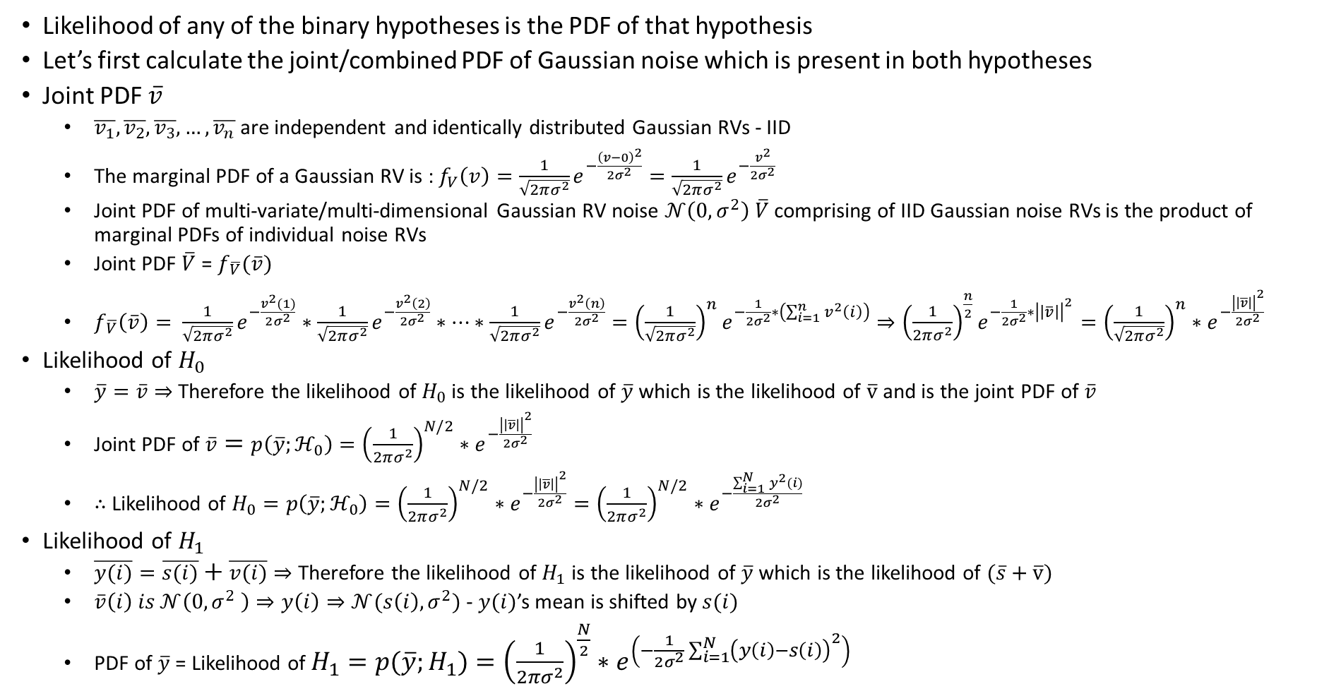
Likelihood Ratio Test for Detection - LRT
Likelihood of any of the binary hypotheses is the PDF of that hypothesis
Let’s first calculate the joint/combined PDF of Gaussian noise which is present in both hypotheses
Joint PDF $\overline{v}$
  $\overline{v_{1}}, \overline{v_{2}}, \overline{v_{3}},…,\overline{v_{n}}$ are independent and identically distributed Gaussian RVs - IID
  The marginal PDF of a Gaussian RV is : $f_{V}\left(v\right)=\frac{1}{\sqrt{2πσ^{2}}}e^{−\frac{{\left(v−0\right)}^{2}}{2σ^{2}}}=\frac{1}{\sqrt{2πσ^{2}}}e^{−\frac{v^{2}}{2σ^{2}}}$
  Joint PDF of multi-variate/multi-dimensional Gaussian RV noise $𝒩\left(0, σ^{2}\right) \overline{V}$ comprising of IID Gaussian noise RVs is the product of marginal PDFs of individual noise RVs
  Joint PDF $\overline{V}$ = $f_{\overline{V}}(\overline{v})$
  $f_{\overline{V}}\left(\overline{v}\right)= \frac{1}{\sqrt{2πσ^{2}}}e^{−\frac{v^{2}(1)}{2σ^{2}}}∗\frac{1}{\sqrt{2πσ^{2}}}e^{−\frac{v^{2}\left(2\right)}{2σ^{2}}}∗…∗\frac{1}{\sqrt{2πσ^{2}}}e^{−\frac{v^{2}\left(n\right)}{2σ^{2}}}={\left(\frac{1}{\sqrt{2πσ^{2}}}\right)}^{n}e^{−\frac{1}{2σ^{2}}∗\left(\sum_{i=1}^{n}{v^{2}\left(i\right)}\right)}⇒{\left(\frac{1}{2πσ^{2}}\right)}^{\frac{n}{2}}e^{−\frac{1}{2σ^{2}}∗{\left|\left|\overline{v}\right|\right|}^{2}}={\left(\frac{1}{\sqrt{2πσ^{2}}}\right)}^{n}∗e^{−\frac{{\left|\left|\overline{v}\right|\right|}^{2}}{2σ^{2}}}$
Likelihood of $H_{0}$
  $\overline{y}=\overline{v}⇒$ Therefore the likelihood of $H_{0}$ is the likelihood of $\overline{y}$ which is the likelihood of $\overline{v}$ and is the joint PDF of $\overline{v}$
  Joint PDF of $\overline{v}=p\left(\overline{y};ℋ_{0}\right)={\left(\frac{1}{2πσ^{2}}\right)}^{N/2}∗e^{−\frac{{\left|\left|\overline{v}\right|\right|}^{2}}{2σ^{2}}}$
  $∴$Likelihood of $H_{0}=p\left(\overline{y};ℋ_{0}\right)={\left(\frac{1}{2πσ^{2}}\right)}^{N/2}∗e^{−\frac{{\left|\left|\overline{v}\right|\right|}^{2}}{2σ^{2}}}={\left(\frac{1}{2πσ^{2}}\right)}^{N/2}∗e^{−\frac{\sum_{i=1}^{N}{y^{2}(i)}}{2σ^{2}}}$
Likelihood of $H_{1}$
  $\overline{y(i)}=\overline{s(i)}+\overline{v(i)}⇒$ Therefore the likelihood of $H_{1}$ is the likelihood of $\overline{y}$ which is the likelihood of $(\overline{s}+\overline{v})$
  $\overline{v}\left(i\right) is 𝒩\left(0, σ^{2} \right)⇒y\left(i\right)⇒𝒩(s\left(i\right),σ^{2})$ - $y(i)$’s mean is shifted by $s(i)$
  PDF of $\overline{y}$ = Likelihood of $H_{1}=p(\overline{y};H_{1})={\left(\frac{1}{2πσ^{2}}\right)}^{\frac{N}{2}}∗e^{\left(−\frac{1}{2σ^{2}}\sum_{i=1}^{N}{{\left(y\left(i\right)−s\left(i\right)\right)}^{2}}\right)}$

Slide 6
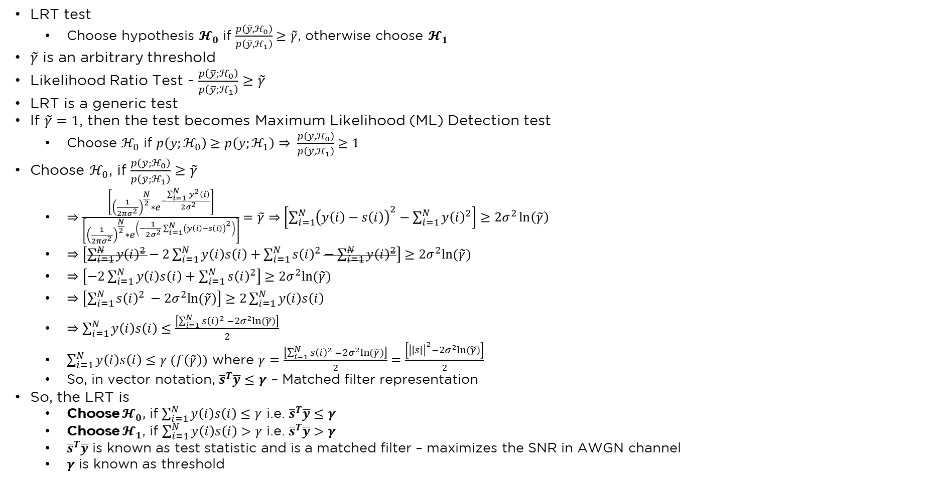
LRT – Likelihood Ration Test
LRT test
  Choose hypothesis $𝓗_{0}$ if $\frac{p\left(\overline{y}, ℋ_{0}\right)}{p\left(\overline{y},ℋ_{1}\right)}≥\tilde{γ}$, otherwise choose $𝓗_{1}$
$\tilde{γ}$ is an arbitrary threshold
Likelihood Ratio Test - $\frac{p\left(\overline{y};ℋ_{0}\right)}{p\left(\overline{y};ℋ_{1}\right)}≥\tilde{γ}$
LRT is a generic test
If $\tilde{γ}=1$, then the test becomes Maximum Likelihood (ML) Detection test
  Choose $ℋ_{0}$ if $p\left(\overline{y};ℋ_{0}\right)≥p\left(\overline{y};ℋ_{1}\right)⇒ \frac{p\left(\overline{y}, ℋ_{0}\right)}{p\left(\overline{y},ℋ_{1}\right)}≥1$
Choose $ℋ_{0}$, if $\frac{p\left(\overline{y};ℋ_{0}\right)}{p\left(\overline{y};ℋ_{1}\right)}≥\tilde{γ}$
  $⇒$ $\frac{\left[{\left(\frac{1}{2πσ^{2}}\right)}^{\frac{N}{2}}∗e^{−\frac{\sum_{i=1}^{N}{y^{2}\left(i\right)}}{2σ^{2}}}\right]}{\left[{\left(\frac{1}{2πσ^{2}}\right)}^{\frac{N}{2}}∗e^{\left(−\frac{1}{2σ^{2}}\sum_{i=1}^{N}{{\left(y\left(i\right)−s\left(i\right)\right)}^{2}}\right)}\right]}=\tilde{γ}⇒\left[\sum_{i=1}^{N}{{\left(y\left(i\right)−s\left(i\right)\right)}^{2}}−\sum_{i=1}^{N}{{y\left(i\right)}^{2}}\right]≥2σ^{2}\ln\left(\tilde{γ}\right)$
  $⇒\left[\sum_{i=1}^{N}{{y\left(i\right)}^{2}}−2\sum_{i=1}^{N}{y\left(i\right)s\left(i\right)}+\sum_{i=1}^{N}{{s\left(i\right)}^{2}}−\sum_{i=1}^{N}{{y\left(i\right)}^{2}}\right]≥2σ^{2}ln⁡(\tilde{γ})$
  $⇒\left[−2\sum_{i=1}^{N}{y\left(i\right)s\left(i\right)}+\sum_{i=1}^{N}{{s\left(i\right)}^{2}}\right]≥2σ^{2}ln⁡(\tilde{γ})$
  $⇒\left[\sum_{i=1}^{N}{{s\left(i\right)}^{2} −2σ^{2}ln⁡(\tilde{γ})}\right]≥2\sum_{i=1}^{N}{y\left(i\right)s\left(i\right)}$
  $⇒\sum_{i=1}^{N}{y\left(i\right)s\left(i\right)}≤\frac{\left[\sum_{i=1}^{N}{{s\left(i\right)}^{2} −2σ^{2}ln⁡(\tilde{γ})}\right]}{2}$
  $\sum_{i=1}^{N}{y\left(i\right)s\left(i\right)}≤γ (f\left(\tilde{γ}\right))$ where $γ=\frac{\left[\sum_{i=1}^{N}{{s\left(i\right)}^{2} −2σ^{2}ln⁡(\tilde{γ})}\right]}{2}=\frac{\left[{\left|\left|\overline{s}\right|\right|}^{2}−2σ^{2}ln⁡(\tilde{γ})\right]}{2}$
  So, in vector notation, ${\overline{s}}^{T}\overline{y}≤γ$ – Matched filter representation
So, the LRT is
  Choose $𝓗_{0},$ if $\sum_{i=1}^{N}{y\left(i\right)s\left(i\right)}≤γ$ i.e. ${\overline{s}}^{T}\overline{y}≤γ$
  Choose $𝓗_{1}$, if $\sum_{i=1}^{N}{y\left(i\right)s\left(i\right)}>γ$ i.e. ${\overline{s}}^{T}\overline{y}>γ$
  ${\overline{s}}^{T}\overline{y}$ is known as test statistic and is a matched filter – maximizes the SNR in AWGN channel
  $γ$ is known as threshold

Slide 7
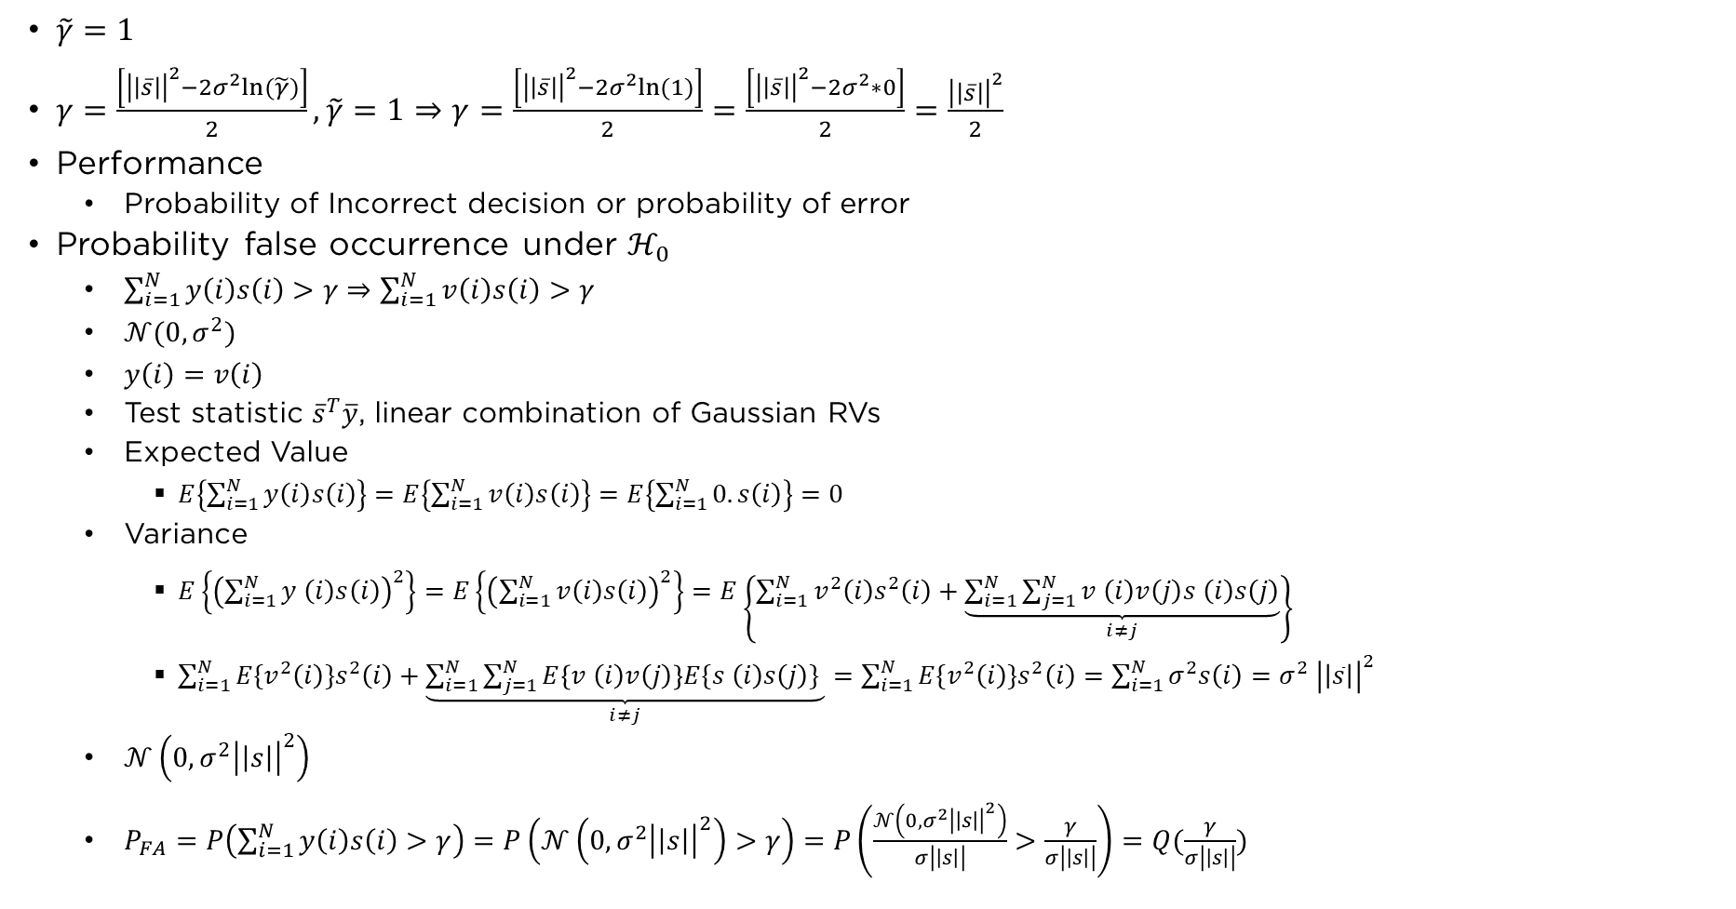
ML Detector
$\tilde{γ}=1$
$γ=\frac{\left[{\left|\left|\overline{s}\right|\right|}^{2}−2σ^{2}ln⁡(\tilde{γ})\right]}{2}, \tilde{γ}=1⇒γ=\frac{\left[{\left|\left|\overline{s}\right|\right|}^{2}−2σ^{2}ln⁡(1)\right]}{2}=\frac{\left[{\left|\left|\overline{s}\right|\right|}^{2}−2σ^{2}∗0\right]}{2}=\frac{{\left|\left|\overline{s}\right|\right|}^{2}}{2}$
Performance
  Probability of Incorrect decision or probability of error
Probability false occurrence under $ℋ_{0}$
  $\sum_{i=1}^{N}{y\left(i\right)s\left(i\right)>γ}⇒\sum_{i=1}^{N}{v\left(i\right)s\left(i\right)>γ}$
  $𝒩(0,σ^{2})$
  $y\left(i\right)=v\left(i\right)$
  Test statistic ${\overline{s}}^{T}\overline{y}$, linear combination of Gaussian RVs
  Expected Value
    $E\left\{\sum_{i=1}^{N}{y\left(i\right)s\left(i\right)}\right\}=E\left\{\sum_{i=1}^{N}{v\left(i\right)s\left(i\right)}\right\}=E\left\{\sum_{i=1}^{N}{0.s\left(i\right)}\right\}=0$
  Variance
    $E\left\{{\left(\sum_{i=1}^{N}{y^{ }\left(i\right)s\left(i\right)}\right)}^{2}\right\}=E\left\{{\left(\sum_{i=1}^{N}{v\left(i\right)s\left(i\right)}\right)}^{2}\right\}=E\left\{\sum_{i=1}^{N}{v^{2}\left(i\right)s^{2}\left(i\right)}+\underset{i≠j}{\underbrace{\sum_{i=1}^{N}{\sum_{j=1}^{N}{v^{ }\left(i\right)v\left(j\right)s^{ }\left(i\right)s\left(j\right)}}}}\right\}$
    $\sum_{i=1}^{N}{{E\{v}^{2}\left(i\right)\}s^{2}\left(i\right)}+\underset{i≠j}{\underbrace{\sum_{i=1}^{N}{\sum_{j=1}^{N}{E\left\{v^{ }\left(i\right)v\left(j\right)\right\}E\{s^{ }\left(i\right)s\left(j\right)\} }}}}=\sum_{i=1}^{N}{{E\{v}^{2}\left(i\right)\}s^{2}\left(i\right)=}$ $\sum_{i=1}^{N}{σ^{2}s\left(i\right)=σ^{2} {\left|\left|\overline{s}\right|\right|}^{2}}$
  $𝒩\left(0,σ^{2}{\left|\left|s\right|\right|}^{2}\right)$
  $P_{FA}=P\left(\sum_{i=1}^{N}{y\left(i\right)s\left(i\right)>γ}\right)=P\left(𝒩\left(0,σ^{2}{\left|\left|s\right|\right|}^{2}\right)>γ\right)=P\left(\frac{𝒩\left(0,σ^{2}{\left|\left|s\right|\right|}^{2}\right)}{σ\left|\left|s\right|\right|}>\frac{γ}{σ\left|\left|s\right|\right|}\right)=Q(\frac{γ}{σ\left|\left|s\right|\right|})$

Slide 8
Live Interaction – 01-10-2023

Slide 9
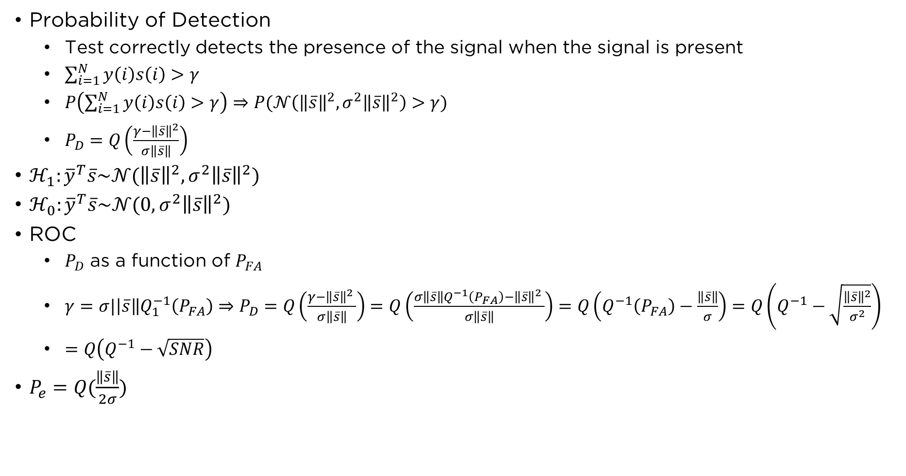
Performance
Probability of Detection
  Test correctly detects the presence of the signal when the signal is present
  $\sum_{i=1}^{N}{y\left(i\right)s\left(i\right)>γ}$
  $P\left(\sum_{i=1}^{N}{y\left(i\right)s\left(i\right)>γ}\right)⇒P(𝒩\left({\left\|\overline{s}\right\|}^{2},σ^{2}{\left\|\overline{s}\right\|}^{2}\right)>γ)$
  $P_{D}=Q\left(\frac{γ−{\left\|\overline{s}\right\|}^{2}}{σ\left\|\overline{s}\right\|}\right)$
$ℋ_{1}:{\overline{y}}^{T}\overline{s}\sim 𝒩({\left\|\overline{s}\right\|}^{2}, σ^{2}{\left\|\overline{s}\right\|}^{2})$
$ℋ_{0}:{\overline{y}}^{T}\overline{s}\sim 𝒩(0, σ^{2}{\left\|\overline{s}\right\|}^{2})$
ROC
  $P_{D}$ as a function of $P_{FA}$
  $γ=σ|\left|\overline{s}\right\|Q_{1}^{−1}\left(P_{FA}\right)⇒P_{D}=Q\left(\frac{γ−{\left\|\overline{s}\right\|}^{2} }{σ\left\|\overline{s}\right\|}\right)=Q\left(\frac{σ\left\|\overline{s}\right\|Q^{−1}\left(P_{FA}\right)−{\left\|\overline{s}\right\|}^{2} }{σ\left\|\overline{s}\right\|}\right)=Q\left(Q^{−1}\left(P_{FA}\right)−\frac{\left\|\overline{s}\right\|}{σ}\right)=Q\left(Q^{−1}−\sqrt{\frac{{\left\|\overline{s}\right\|}^{2}}{σ^{2}}}\right)$
  $=Q\left(Q^{−1}−\sqrt{SNR}\right)$
$P_{e}=Q(\frac{\left\|\overline{s}\right\|}{2σ})$

Slide 10
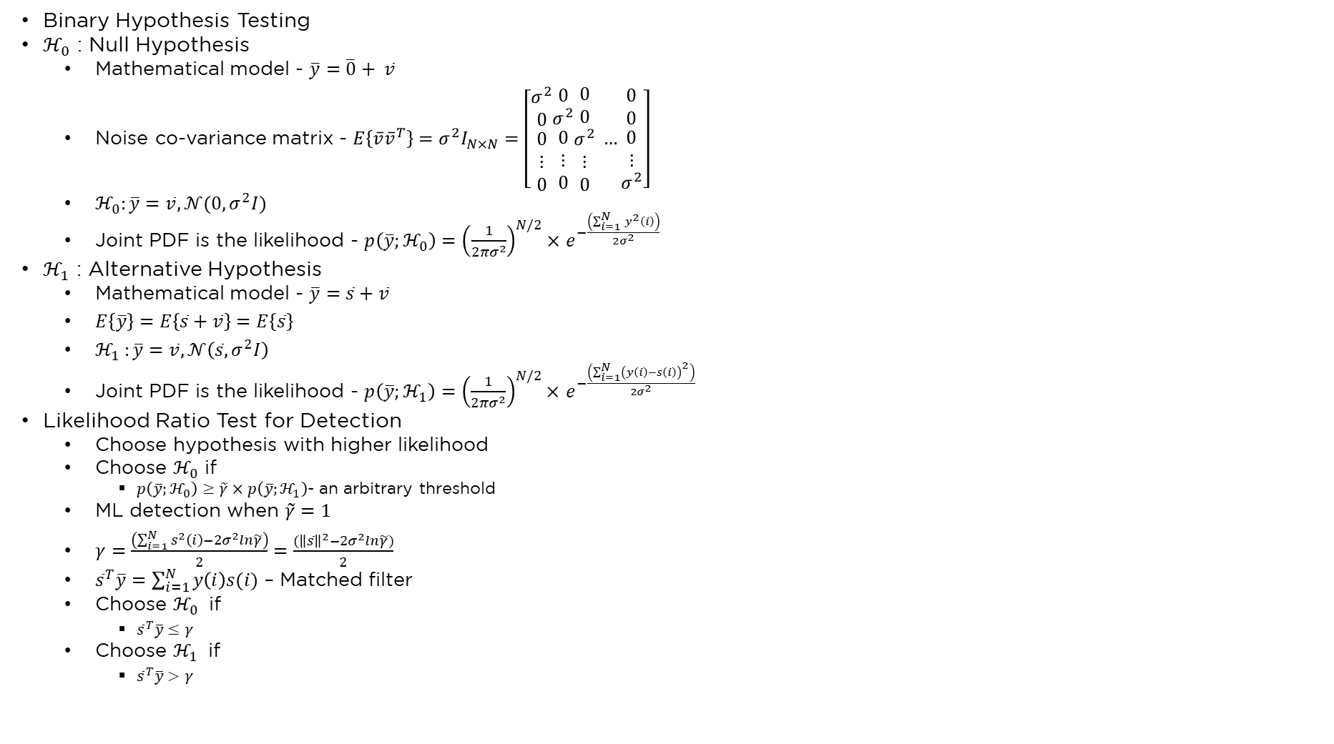
Quiz – 1 – 15th Oct 2023
Binary Hypothesis Testing
$ℋ_{0}$ : Null Hypothesis
  Mathematical model - $\overline{y}=\overline{0}+ \overline{v}$
  Noise co-variance matrix - $E\left\{\overline{v}{\overline{v}}^{T}\right\}=σ^{2}I_{N×N}=\left[\begin{matrix}σ^{2} \\ 0 \\ \begin{aligned}0 \\ ⋮ \\ 0\end{aligned}\end{matrix}\begin{matrix}0 \\ σ^{2} \\ \begin{aligned}0 \\ ⋮ \\ 0\end{aligned}\end{matrix}\begin{matrix}0 \\ 0 \\ \begin{aligned}σ^{2} \\ ⋮ \\ 0\end{aligned}\end{matrix} …\begin{matrix}0 \\ 0 \\ \begin{aligned}0 \\ ⋮ \\ σ^{2}\end{aligned}\end{matrix}\right]$
  $ℋ_{0}:\overline{y}=\overline{v}, 𝒩(0,σ^{2}I)$
  Joint PDF is the likelihood - $p\left(\overline{y};ℋ_{0}\right)={\left(\frac{1}{2πσ^{2}}\right)}^{N/2}×$ $e^{−\frac{\left(\sum_{i=1}^{N}{y^{2}\left(i\right)}\right)}{2σ^{2}}}$
$ℋ_{1}$ : Alternative Hypothesis
  Mathematical model - $\overline{y}=\overline{s}+\overline{v}$
  $E\left\{\overline{y}\right\}=E\left\{\overline{s}+\overline{v}\right\}=E\left\{\overline{s}\right\}$
  ${ℋ_{1}}_{ }:\overline{y}=\overline{v}, 𝒩\left(\overline{s},σ^{2}I\right)$
  Joint PDF is the likelihood - $p\left(\overline{y};ℋ_{1}\right)={\left(\frac{1}{2πσ^{2}}\right)}^{N/2}×$ $e^{−\frac{\left(\sum_{i=1}^{N}{{\left(y\left(i\right)−s\left(i\right)\right)}^{2}}\right)}{2σ^{2}}}$
Likelihood Ratio Test for Detection
  Choose hypothesis with higher likelihood
  Choose $ℋ_{0}$ if
    $p\left(\overline{y};ℋ_{0}\right)≥\tilde{γ}×p\left(\overline{y};ℋ_{1}\right)$- an arbitrary threshold
  ML detection when $\tilde{γ}=1$
  $γ=\frac{\left(\sum_{i=1}^{N}{s^{2}\left(i\right)}−2σ^{2}ln\tilde{γ}\right)}{2}=\frac{({\left\|\overline{s}\right\|}^{2}−2σ^{2}ln\tilde{γ})}{2}$
  ${\overline{s}}^{T}\overline{y}=\sum_{i=1}^{N}{y\left(i\right)s(i)}$ – Matched filter
  Choose $ℋ_{0}$ if
    ${\overline{s}}^{T}\overline{y}≤γ$
  Choose $ℋ_{1}$ if
    ${\overline{s}}^{T}\overline{y}>γ$

Slide 11
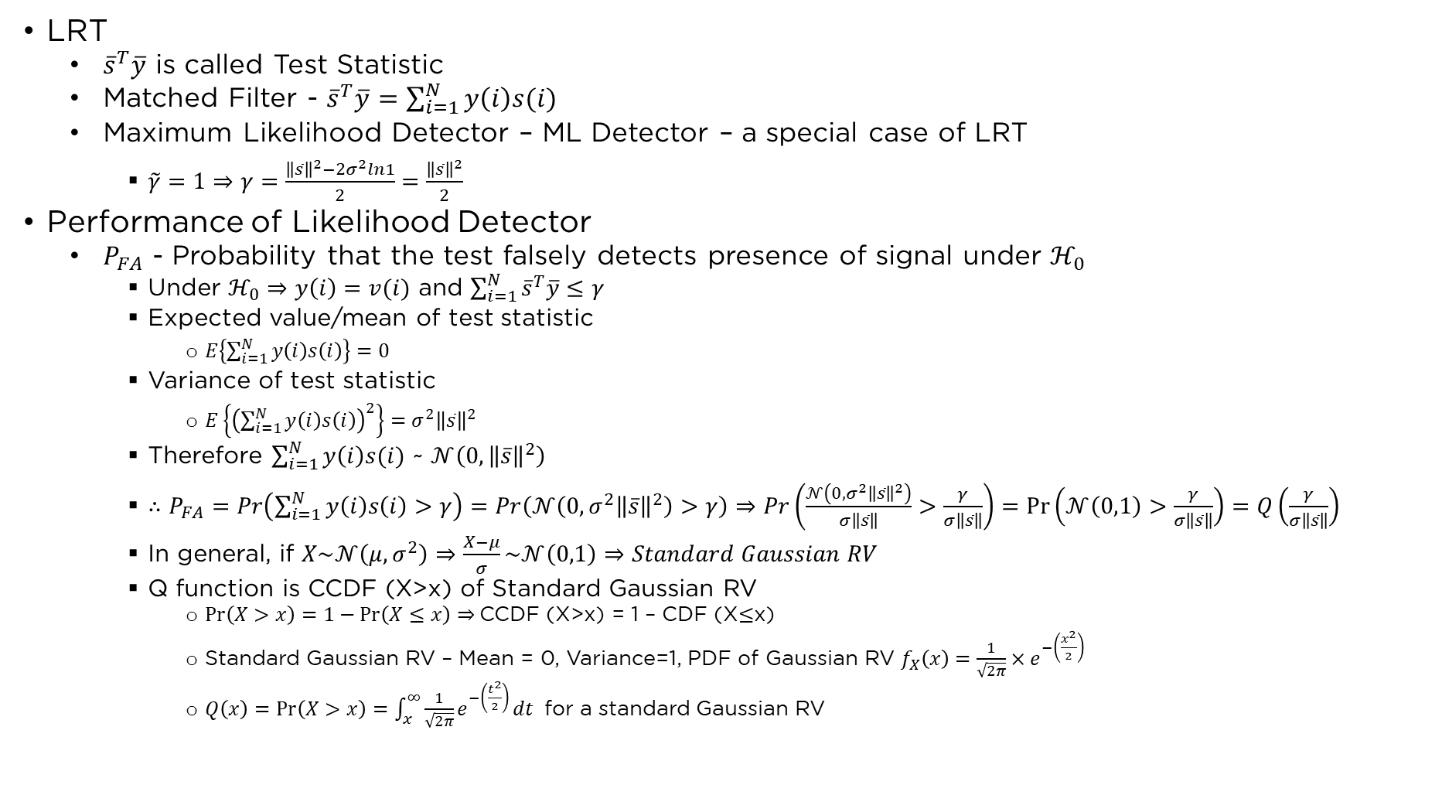
Quiz – 1 – 15th Oct 2023
LRT
  ${\overline{s}}^{T}\overline{y}$ is called Test Statistic
  Matched Filter - ${\overline{s}}^{T}\overline{y}=\sum_{i=1}^{N}{y\left(i\right)s(i)}$
  Maximum Likelihood Detector – ML Detector – a special case of LRT
    $\tilde{γ}=1⇒γ=\frac{{\left\|\overline{s}\right\|}^{2}−2σ^{2}ln1}{2}=\frac{{\left\|\overline{s}\right\|}^{2}}{2}$
Performance of Likelihood Detector
  $P_{FA}$ - Probability that the test falsely detects presence of signal under $ℋ_{0}$
    Under $ℋ_{0}⇒y\left(i\right)=v(i)$ and $\sum_{i=1}^{N}{{\overline{s}}^{T}\overline{y}≤γ}$
    Expected value/mean of test statistic
      $E\left\{\sum_{i=1}^{N}{y\left(i\right)s\left(i\right)}\right\}=0$
    Variance of test statistic
      $E\left\{{\left(\sum_{i=1}^{N}{y\left(i\right)s\left(i\right)}\right)}^{2}\right\}=σ^{2}{\left\|\overline{s}\right\|}^{2}$
    Therefore $\sum_{i=1}^{N}{y\left(i\right)s(i)}$ ~ $𝒩\left(0, {\left\|\overline{s}\right\|}^{2}\right)$
    $∴P_{FA}=Pr\left(\sum_{i=1}^{N}{y\left(i\right)s\left(i\right)}>γ\right)=Pr\left(𝒩\left(0,σ^{2}{\left\|\overline{s}\right\|}^{2}\right)>γ\right)⇒Pr\left(\frac{𝒩\left(0,σ^{2}{\left\|\overline{s}\right\|}^{2}\right)}{σ\left\|\overline{s}\right\|}>\frac{γ}{σ\left\|\overline{s}\right\|}\right)=\operatorname{Pr}\left(𝒩\left(0,1\right)>\frac{γ}{σ\left\|\overline{s}\right\|}\right)=Q\left(\frac{γ}{σ\left\|\overline{s}\right\|}\right)$
    In general, if $X\sim 𝒩\left(μ,σ^{2}\right)⇒\frac{X−μ}{σ}\sim 𝒩\left(0,1\right)⇒Standard Gaussian RV$
    Q function is CCDF (X>x) of Standard Gaussian RV
      $\operatorname{Pr}\left(X>x\right)=1−\operatorname{Pr}\left(X≤x\right)⇒$CCDF (X>x) = 1 – CDF (X$≤$x)
      Standard Gaussian RV – Mean = 0, Variance=1, PDF of Gaussian RV $f_{X}\left(x\right)=\frac{1}{\sqrt{2π}}×e^{−\left(\frac{x^{2}}{2}\right)}$
      $Q\left(x\right)=\operatorname{Pr}\left(X>x\right)=\int_{x}^{∞}{\frac{1}{\sqrt{2π}}e^{−\left(\frac{t^{2}}{2}\right)}}dt$ for a standard Gaussian RV

Slide 12
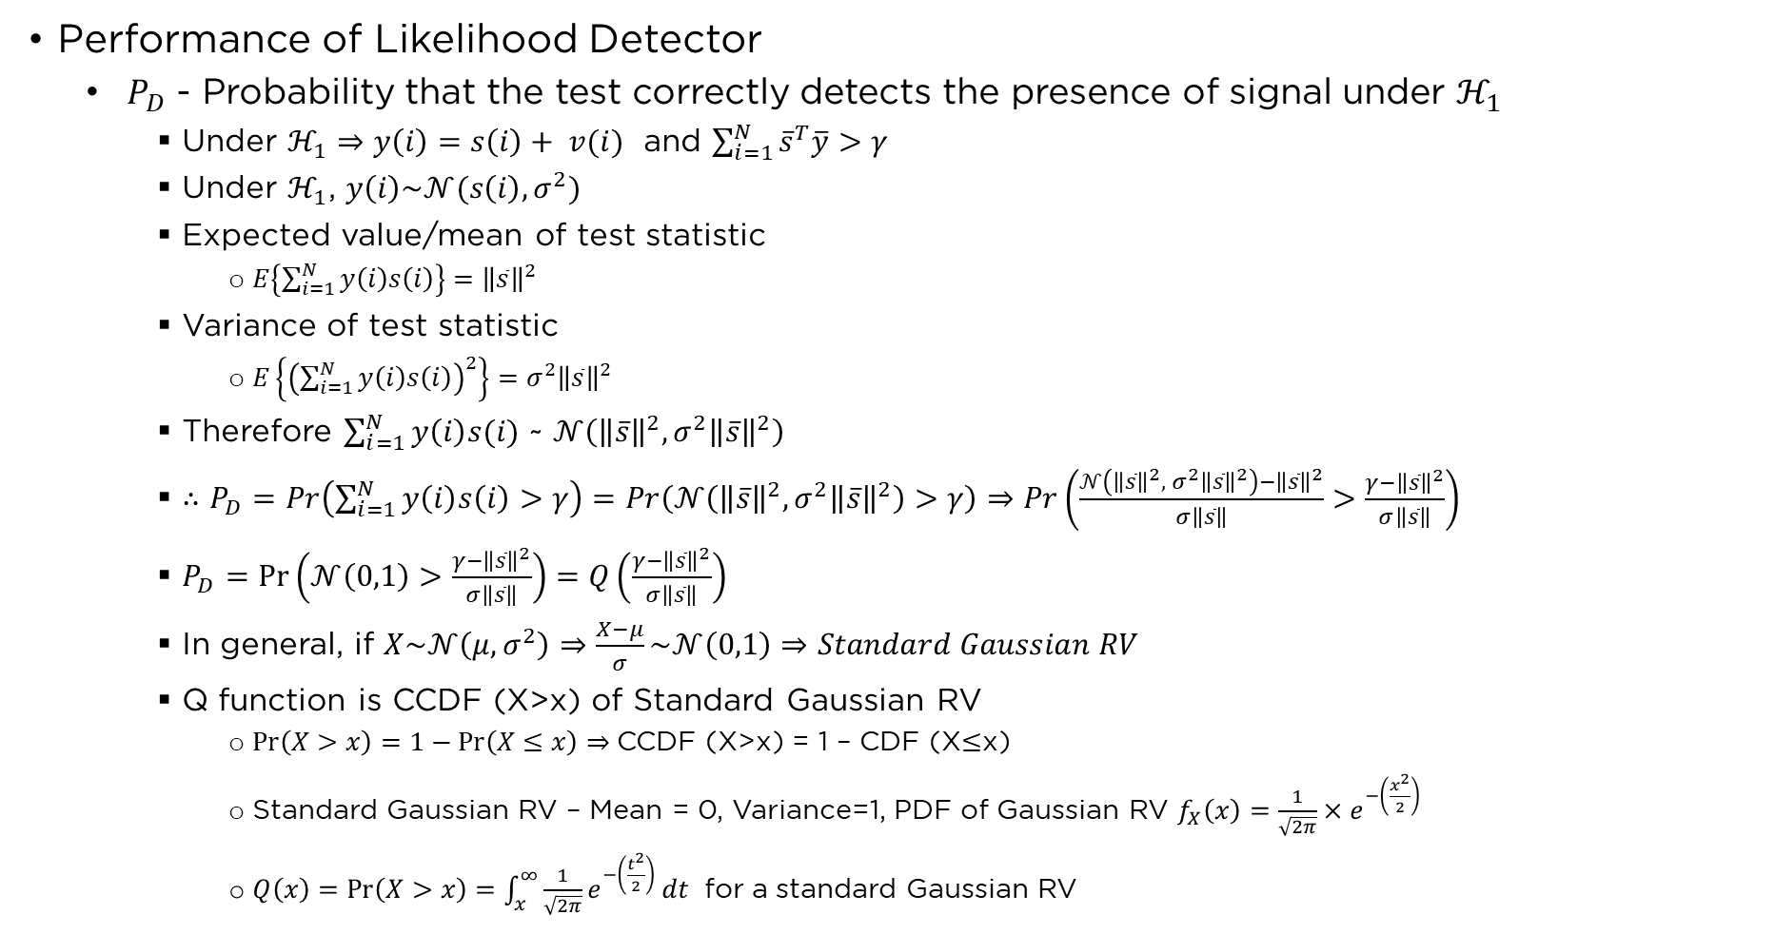
Quiz – 1 – 15th Oct 2023
Performance of Likelihood Detector
  $P_{D}$ - Probability that the test correctly detects the presence of signal under $ℋ_{1}$
    Under $ℋ_{1}⇒y\left(i\right)=s\left(i\right)+ v(i)$ and $\sum_{i=1}^{N}{{\overline{s}}^{T}\overline{y}}>γ$
    Under $ℋ_{1}$, $y\left(i\right)\sim 𝒩(s\left(i\right),σ^{2})$
    Expected value/mean of test statistic
      $E\left\{\sum_{i=1}^{N}{y\left(i\right)s\left(i\right)}\right\}={\left\|\overline{s}\right\|}^{2}$
    Variance of test statistic
      $E\left\{{\left(\sum_{i=1}^{N}{y\left(i\right)s\left(i\right)}\right)}^{2}\right\}=σ^{2}{\left\|\overline{s}\right\|}^{2}$
    Therefore $\sum_{i=1}^{N}{y\left(i\right)s(i)}$ ~ $𝒩\left({\left\|\overline{s}\right\|}^{2}, σ^{2}{\left\|\overline{s}\right\|}^{2}\right)$
    $∴P_{D}=Pr\left(\sum_{i=1}^{N}{y\left(i\right)s\left(i\right)}>γ\right)=Pr\left(𝒩\left({\left\|\overline{s}\right\|}^{2},σ^{2}{\left\|\overline{s}\right\|}^{2}\right)>γ\right)⇒Pr\left(\frac{𝒩\left({\left\|\overline{s}\right\|}^{2}, σ^{2}{\left\|\overline{s}\right\|}^{2}\right)−{\left\|\overline{s}\right\|}^{2}}{σ\left\|\overline{s}\right\|}>\frac{γ−{\left\|\overline{s}\right\|}^{2}}{σ\left\|\overline{s}\right\|}\right)$
    $P_{D}=\operatorname{Pr}\left(𝒩\left(0,1\right)>\frac{γ−{\left\|\overline{s}\right\|}^{2}}{σ\left\|\overline{s}\right\|}\right)=Q\left(\frac{γ−{\left\|\overline{s}\right\|}^{2}}{σ\left\|\overline{s}\right\|}\right)$
    In general, if $X\sim 𝒩\left(μ,σ^{2}\right)⇒\frac{X−μ}{σ}\sim 𝒩\left(0,1\right)⇒Standard Gaussian RV$
    Q function is CCDF (X>x) of Standard Gaussian RV
      $\operatorname{Pr}\left(X>x\right)=1−\operatorname{Pr}\left(X≤x\right)⇒$CCDF (X>x) = 1 – CDF (X$≤$x)
      Standard Gaussian RV – Mean = 0, Variance=1, PDF of Gaussian RV $f_{X}\left(x\right)=\frac{1}{\sqrt{2π}}×e^{−\left(\frac{x^{2}}{2}\right)}$
      $Q\left(x\right)=\operatorname{Pr}\left(X>x\right)=\int_{x}^{∞}{\frac{1}{\sqrt{2π}}e^{−\left(\frac{t^{2}}{2}\right)}}dt$ for a standard Gaussian RV

Slide 13
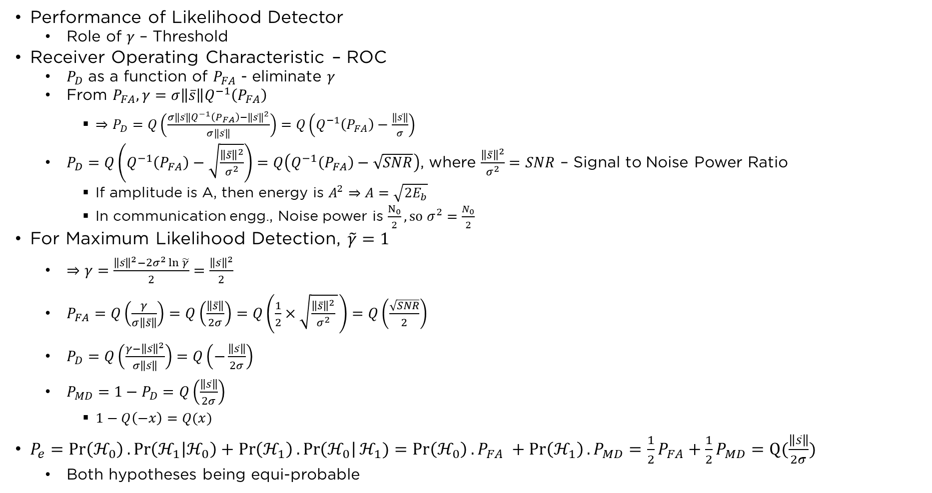
Quiz – 1 – 15th Oct 2023
Performance of Likelihood Detector
  Role of $γ$ – Threshold
Receiver Operating Characteristic – ROC
  $P_{D}$ as a function of $P_{FA}$ - eliminate $γ$
  From $P_{FA}, γ=σ\left\|\overline{s}\right\|Q^{−1}\left(P_{FA}\right)$
    $⇒P_{D}=Q\left(\frac{σ\left\|\overline{s}\right\|Q^{−1}\left(P_{FA}\right)−{\left\|\overline{s}\right\|}^{2}}{σ\left\|\overline{s}\right\|}\right)=Q\left(Q^{−1}\left(P_{FA}\right)−\frac{\left\|\overline{s}\right\|}{σ}\right)$
  $P_{D}=Q\left(Q^{−1}\left(P_{FA}\right)−\sqrt{\frac{{\left\|\overline{s}\right\|}^{2}}{σ^{2}}}\right)=Q\left(Q^{−1}\left(P_{FA}\right)−\sqrt{SNR}\right)$, where $\frac{{\left\|\overline{s}\right\|}^{2}}{σ^{2}}=SNR$ – Signal to Noise Power Ratio
    If amplitude is A, then energy is $A^{2}⇒A=\sqrt{2E_{b}}$
    In communication engg., Noise power is $\frac{N_{0}}{2}, so σ^{2}=\frac{N_{0}}{2}$
For Maximum Likelihood Detection, $\tilde{γ}=1$
  $⇒γ=\frac{{\left\|\overline{s}\right\|}^{2}−2σ^{2}\ln{\tilde{γ}}}{2}=\frac{{\left\|\overline{s}\right\|}^{2}}{2}$
  $P_{FA}=Q\left(\frac{γ}{σ\left\|\overline{s}\right\|}\right)=Q\left(\frac{\left\|\overline{s}\right\|}{2σ}\right)=Q\left(\frac{1}{2}×\sqrt{\frac{{\left\|\overline{s}\right\|}^{2}}{σ^{2}} }\right)=Q\left(\frac{\sqrt{SNR}}{2}\right)$
  $P_{D}=Q\left(\frac{γ−{\left\|\overline{s}\right\|}^{2}}{σ\left\|\overline{s}\right\|}\right)=Q\left(−\frac{\left\|\overline{s}\right\|}{2σ}\right)$
  $P_{MD}=1−P_{D}=Q\left(\frac{\left\|\overline{s}\right\|}{2σ}\right)$
    $1−Q\left(−x\right)=Q(x)$
$P_{e}=\operatorname{Pr}\left(ℋ_{0}\right).\operatorname{Pr}\left(ℋ_{1} | ℋ_{0}\right)+\operatorname{Pr}\left(ℋ_{1}\right).\operatorname{Pr}\left(ℋ_{0}\right|ℋ_{1})=\operatorname{Pr}\left(ℋ_{0}\right).P_{FA} +\operatorname{Pr}\left(ℋ_{1}\right).P_{MD}=\frac{1}{2}P_{FA}+\frac{1}{2}P_{MD}=Q(\frac{\left\|\overline{s}\right\|}{2σ})$
  Both hypotheses being equi-probable

Slide 14
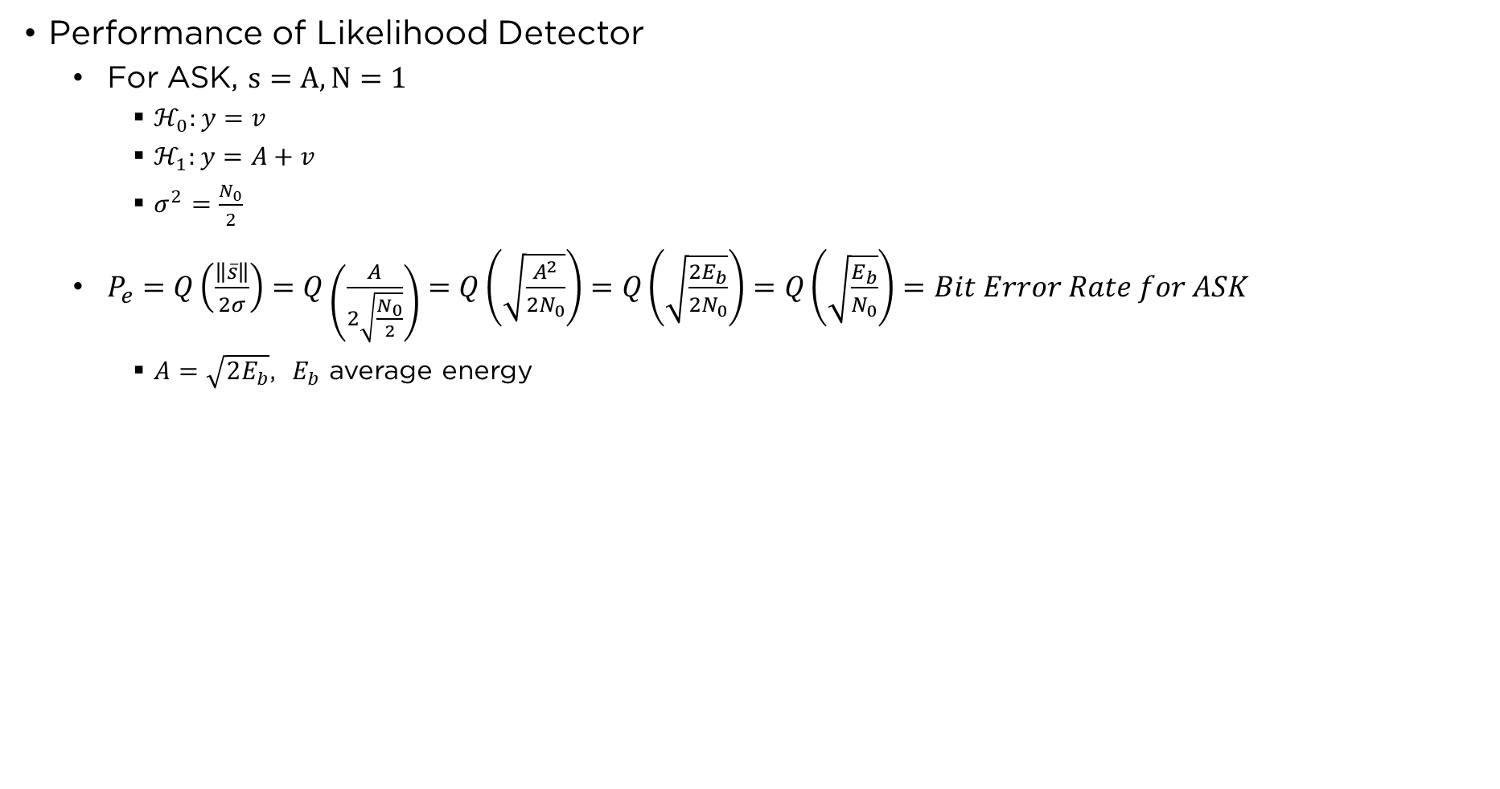
Quiz – 1 – 15th Oct 2023
Performance of Likelihood Detector
  For ASK, $s=A, N=1$
    $ℋ_{0}:y=v$
    $ℋ_{1}:y=A+v$
    $σ^{2}=\frac{N_{0}}{2}$
  $P_{e}=Q\left(\frac{\left\|\overline{s}\right\|}{2σ}\right)=Q\left(\frac{A}{2\sqrt{\frac{N_{0}}{2}}}\right)=Q\left(\sqrt{\frac{A^{2}}{2N_{0}}}\right)=Q\left(\sqrt{\frac{2E_{b}}{2N_{0}}}\right)=Q\left(\sqrt{\frac{E_{b}}{N_{0}}}\right)=Bit Error Rate for ASK$
    $A=\sqrt{2E_{b}}$, $E_{b}$ average energy

Slide 15
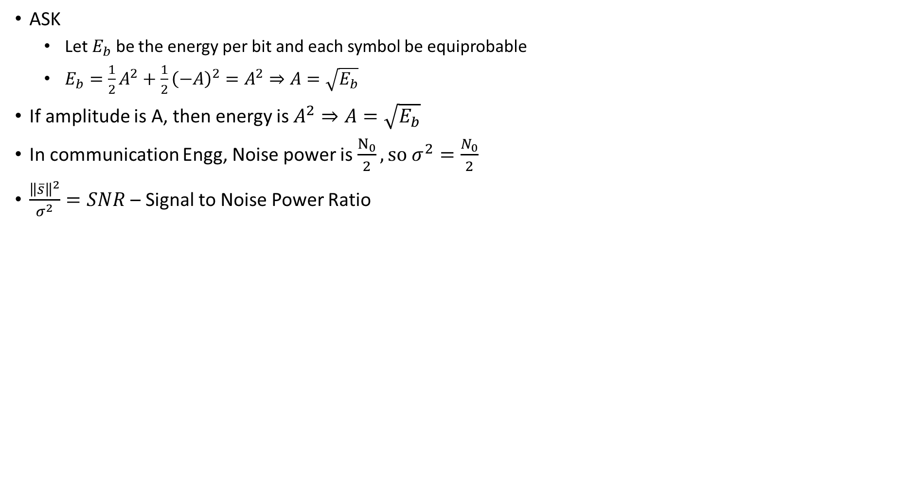
Energy, Variance, SNR Relationship
ASK
  Let $E_{b}$ be the energy per bit and each symbol be equiprobable
  $E_{b}=\frac{1}{2}A^{2}+\frac{1}{2}{\left(−A\right)}^{2}=A^{2}⇒A=\sqrt{E_{b}}$
If amplitude is A, then energy is $A^{2}⇒A=\sqrt{E_{b}}$
In communication Engg, Noise power is $\frac{N_{0}}{2}, so σ^{2}=\frac{N_{0}}{2}$
$\frac{{\left\|\overline{s}\right\|}^{2}}{σ^{2}}=SNR$ – Signal to Noise Power Ratio

Slide 16
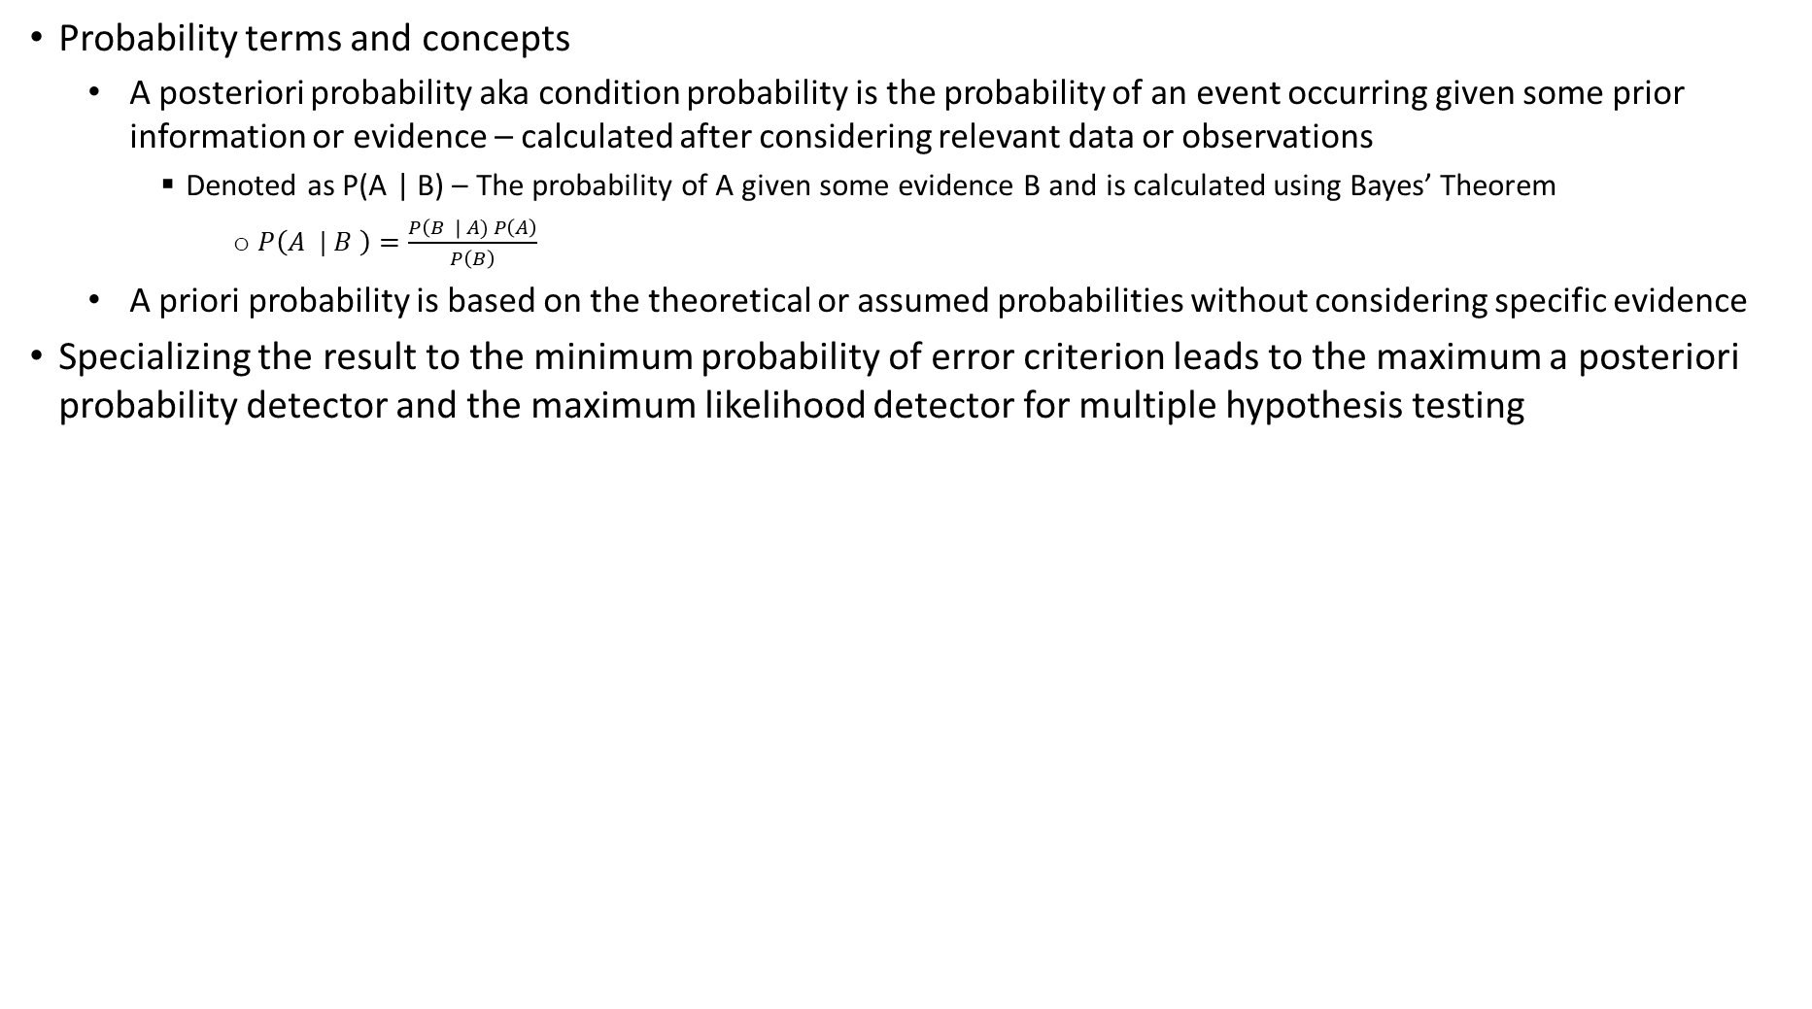
Quiz -2 – 31-10-2023
Probability terms and concepts
  A posteriori probability aka condition probability is the probability of an event occurring given some prior information or evidence – calculated after considering relevant data or observations
    Denoted as P(A | B) – The probability of A given some evidence B and is calculated using Bayes’ Theorem
      $P\left(A | B \right)=\frac{P\left(B \right| A) P\left(A\right)}{P\left(B\right)}$
  A priori probability is based on the theoretical or assumed probabilities without considering specific evidence
Specializing the result to the minimum probability of error criterion leads to the maximum a posteriori probability detector and the maximum likelihood detector for multiple hypothesis testing

Slide 17
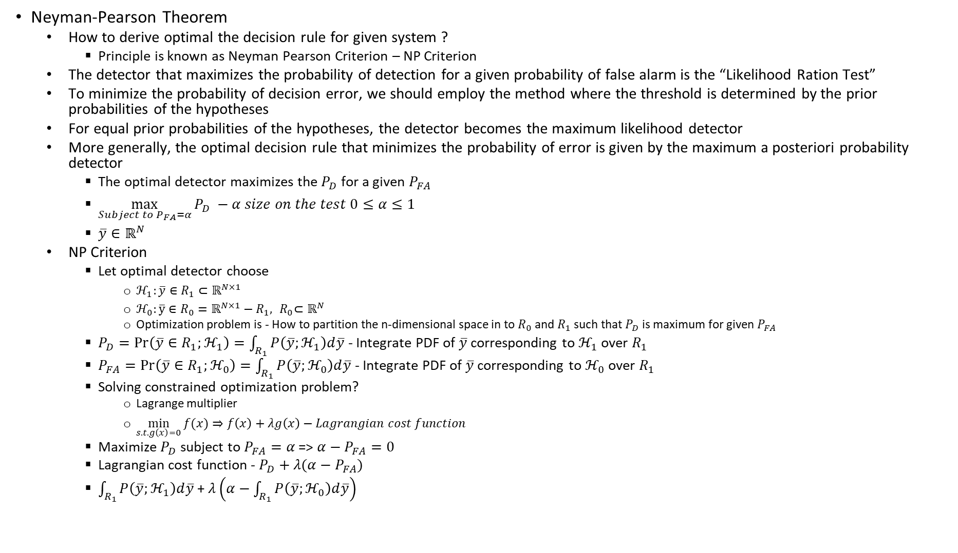
Quiz -2 – 31-10-2023
Neyman-Pearson Theorem
  How to derive optimal the decision rule for given system ?
    Principle is known as Neyman Pearson Criterion – NP Criterion
  The detector that maximizes the probability of detection for a given probability of false alarm is the “Likelihood Ration Test”
  To minimize the probability of decision error, we should employ the method where the threshold is determined by the prior probabilities of the hypotheses
  For equal prior probabilities of the hypotheses, the detector becomes the maximum likelihood detector
  More generally, the optimal decision rule that minimizes the probability of error is given by the maximum a posteriori probability detector
    The optimal detector maximizes the $P_{D}$ for a given $P_{FA}$
    $\max_{Subject to P_{FA}=α}{P_{D}} −α size on the test 0≤α≤1$
    $\overline{y}∈ℝ^{N}$
  NP Criterion
    Let optimal detector choose
      $ℋ_{1}:\overline{y}∈R_{1}⊂ℝ^{N×1}$
      $ℋ_{0}:\overline{y}∈{R_{0}=ℝ^{N×1}−R}_{1}, { R}_{0}⊂ℝ^{N}$
      Optimization problem is - How to partition the n-dimensional space in to $R_{0}$ and $R_{1}$ such that $P_{D}$ is maximum for given $P_{FA}$
    $P_{D}=\operatorname{Pr}\left(\overline{y}∈R_{1};ℋ_{1}\right)=\int_{R_{1}}^{ }{P\left(\overline{y};ℋ_{1}\right)d\overline{y}}$ - Integrate PDF of $\overline{y}$ corresponding to $ℋ_{1}$ over $R_{1}$
    $P_{FA}=\operatorname{Pr}\left(\overline{y}∈R_{1};ℋ_{0}\right)=\int_{R_{1}}^{ }{P\left(\overline{y};ℋ_{0}\right)d\overline{y}}$ - Integrate PDF of $\overline{y}$ corresponding to $ℋ_{0}$ over $R_{1}$
    Solving constrained optimization problem?
      Lagrange multiplier
      $\min_{s.t.g\left(x\right)=0}{f(x)}⇒f\left(x\right)+λg\left(x\right)−Lagrangian cost function$
    Maximize $P_{D}$ subject to $P_{FA}=α$ => $α−P_{FA}=0$
    Lagrangian cost function - $P_{D}+λ(α−P_{FA})$
    $\int_{R_{1}}^{ }{P\left(\overline{y};ℋ_{1}\right)d\overline{y}}$ + $λ\left(α−\int_{R_{1}}^{ }{P\left(\overline{y};ℋ_{0}\right)d\overline{y}}\right)$

Slide 18
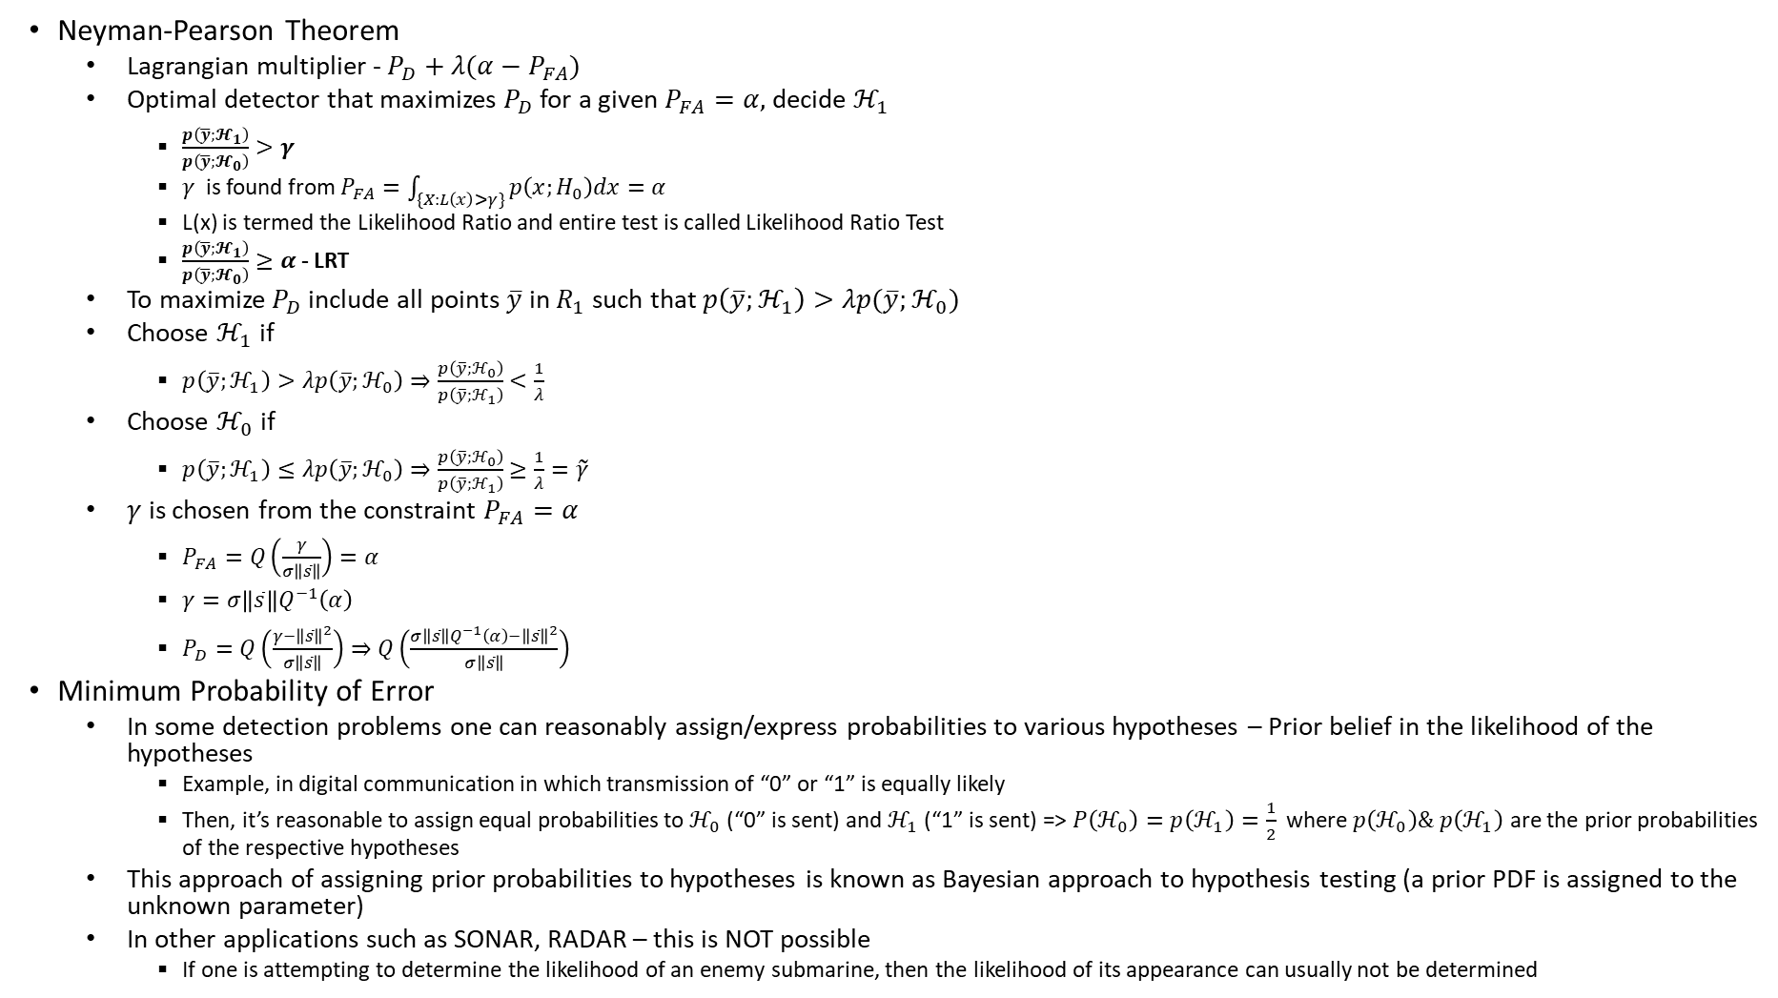
Quiz -2 – 31-10-2023
Neyman-Pearson Theorem
  Lagrangian multiplier - $P_{D}+λ(α−P_{FA})$
  Optimal detector that maximizes $P_{D}$ for a given $P_{FA}=α,$ decide $ℋ_{1}$
    $\frac{p\left(\overline{y};𝓗_{1}\right)}{p\left(\overline{y};𝓗_{0}\right)}>γ$
    $γ$ is found from $P_{FA}=\int_{\{X:L\left(x\right)>γ\}}^{ }{p\left(x;H_{0}\right)dx=α}$
    L(x) is termed the Likelihood Ratio and entire test is called Likelihood Ratio Test
    $\frac{p\left(\overline{y};𝓗_{1}\right)}{p\left(\overline{y};𝓗_{0}\right)}≥α$ - LRT
  To maximize $P_{D}$ include all points $\overline{y}$ in $R_{1}$ such that $p\left(\overline{y};ℋ_{1}\right)>λp(\overline{y};ℋ_{0})$
  Choose $ℋ_{1}$ if
    $p\left(\overline{y};ℋ_{1}\right)>λp\left(\overline{y};ℋ_{0}\right)⇒\frac{p\left(\overline{y};ℋ_{0}\right)}{p\left(\overline{y};ℋ_{1}\right)}<\frac{1}{λ}$
  Choose $ℋ_{0}$ if
    $p\left(\overline{y};ℋ_{1}\right)≤λp\left(\overline{y};ℋ_{0}\right)⇒\frac{p\left(\overline{y};ℋ_{0}\right)}{p\left(\overline{y};ℋ_{1}\right)}≥\frac{1}{λ}=\tilde{γ}$
  $γ$ is chosen from the constraint $P_{FA}=α$
    $P_{FA}=Q\left(\frac{γ}{σ\left\|\overline{s}\right\|}\right)=α$
    $γ=σ\left\|\overline{s}\right\|Q^{−1}\left(α\right)$
    $P_{D}=Q\left(\frac{γ−{\left\|\overline{s}\right\|}^{2}}{σ\left\|\overline{s}\right\|}\right)⇒Q\left(\frac{σ\left\|\overline{s}\right\|Q^{−1}\left(α\right)−{\left\|\overline{s}\right\|}^{2}}{σ\left\|\overline{s}\right\|}\right)$
Minimum Probability of Error
  In some detection problems one can reasonably assign/express probabilities to various hypotheses – Prior belief in the likelihood of the hypotheses
    Example, in digital communication in which transmission of “0” or “1” is equally likely
    Then, it’s reasonable to assign equal probabilities to $ℋ_{0}$(“0” is sent) and $ℋ_{1}$(“1” is sent) => $P\left(ℋ_{0}\right)=p\left(ℋ_{1}\right)=\frac{1}{2}$ where $p\left(ℋ_{0}\right)\& p\left(ℋ_{1}\right)$ are the prior probabilities of the respective hypotheses
  This approach of assigning prior probabilities to hypotheses is known as Bayesian approach to hypothesis testing (a prior PDF is assigned to the unknown parameter)
  In other applications such as SONAR, RADAR – this is NOT possible
    If one is attempting to determine the likelihood of an enemy submarine, then the likelihood of its appearance can usually not be determined

Slide 19
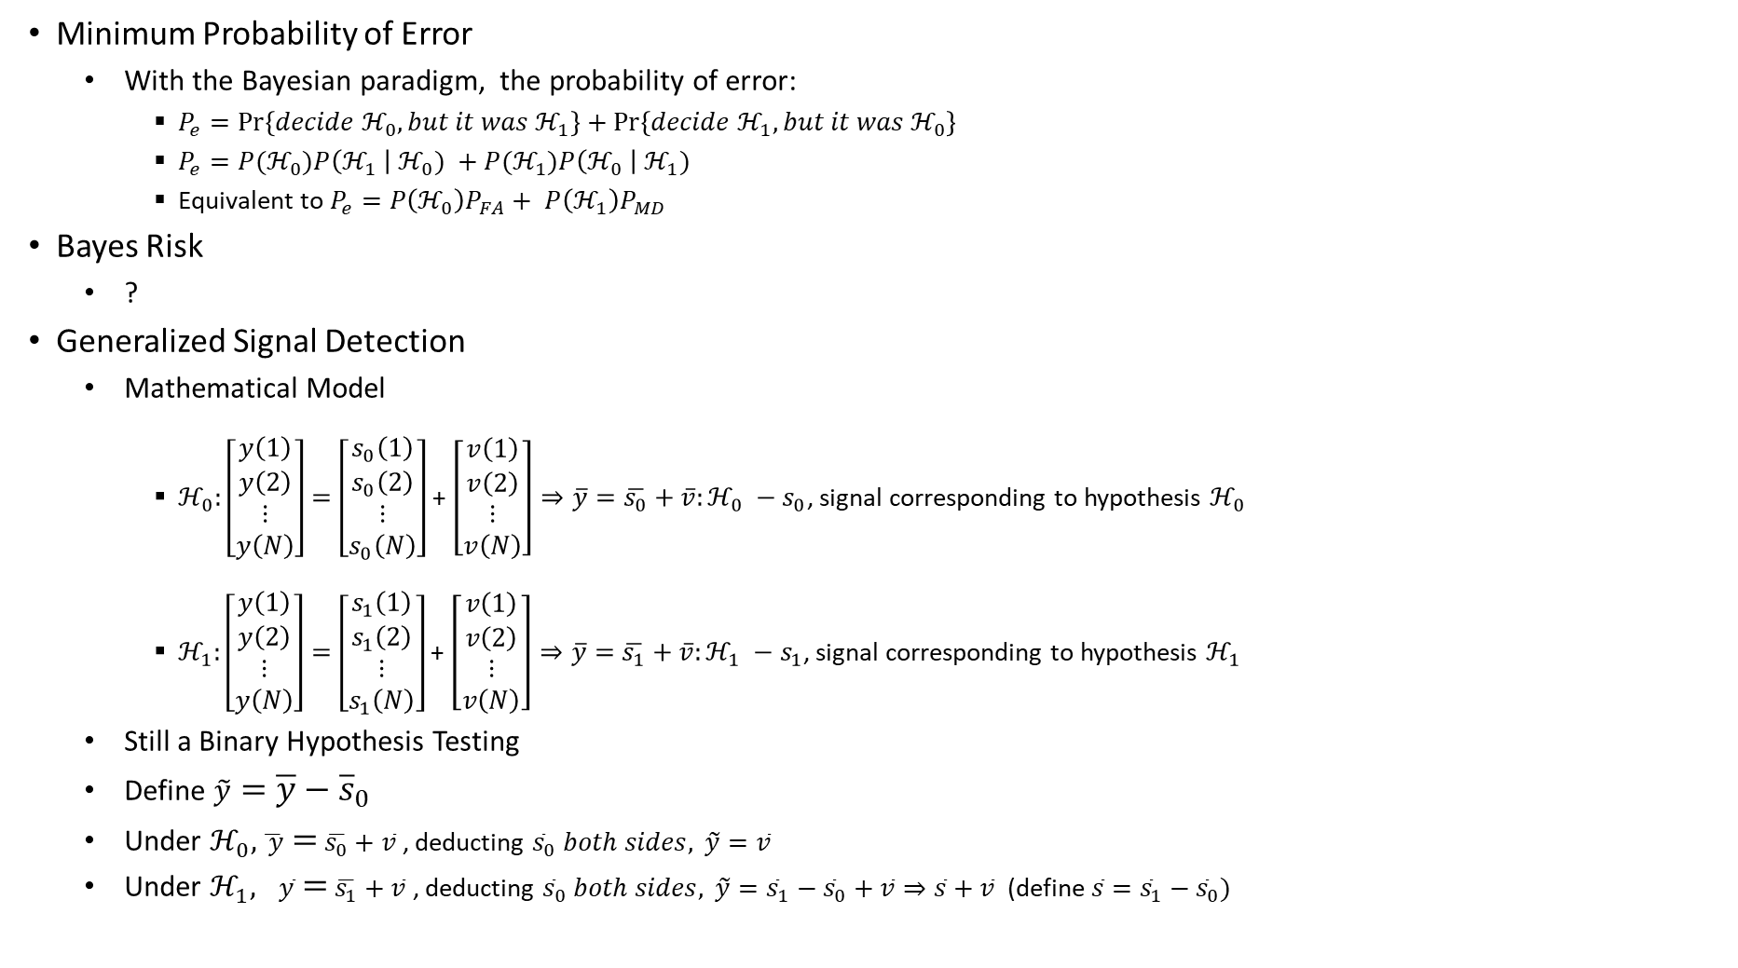
Quiz -2 – 31-10-2023
Minimum Probability of Error
  With the Bayesian paradigm, the probability of error:
    $P_{e}=\operatorname{Pr}\left\{decide ℋ_{0}, but it was ℋ_{1}\right\}+\operatorname{Pr}\left\{decide ℋ_{1}, but it was ℋ_{0}\right\}$
    $P_{e}=P(ℋ_{0})P\left(ℋ_{1} \right|{ ℋ}_{0}) +P(ℋ_{1})P\left(ℋ_{0} \right|{ ℋ}_{1})$
    Equivalent to $P_{e}=P\left(ℋ_{0}\right)P_{FA}+ P\left(ℋ_{1}\right)P_{MD}$
Bayes Risk
  ?
Generalized Signal Detection
  Mathematical Model
    $ℋ_{0}:\left[\begin{matrix}y\left(1\right) \\ y\left(2\right) \\ \begin{aligned}⋮ \\ y\left(N\right)\end{aligned}\end{matrix}\right]=\left[\begin{matrix}s_{0}\left(1\right) \\ s_{0}\left(2\right) \\ \begin{aligned}⋮ \\ s_{0}\left(N\right)\end{aligned}\end{matrix}\right]$ + $\left[\begin{matrix}v\left(1\right) \\ v\left(2\right) \\ \begin{aligned}⋮ \\ v\left(N\right)\end{aligned}\end{matrix}\right]⇒\overline{y}=\overline{s_{0}}+\overline{v}:ℋ_{0} −s_{0}$, signal corresponding to hypothesis $ℋ_{0}$
    $ℋ_{1}:\left[\begin{matrix}y\left(1\right) \\ y\left(2\right) \\ \begin{aligned}⋮ \\ y\left(N\right)\end{aligned}\end{matrix}\right]=\left[\begin{matrix}s_{1}\left(1\right) \\ s_{1}\left(2\right) \\ \begin{aligned}⋮ \\ s_{1}\left(N\right)\end{aligned}\end{matrix}\right]$ + $\left[\begin{matrix}v\left(1\right) \\ v\left(2\right) \\ \begin{aligned}⋮ \\ v\left(N\right)\end{aligned}\end{matrix}\right]⇒\overline{y}=\overline{s_{1}}+\overline{v}:ℋ_{1} −s_{1}$, signal corresponding to hypothesis $ℋ_{1}$
  Still a Binary Hypothesis Testing
  Define $\tilde{y}=\overline{y}−{\overline{s}}_{0}$
  Under $ℋ_{0}, \overline{ y}=$ $\overline{s_{0}}+\overline{v}$, deducting ${\overline{s}}_{0} both sides,$ $\tilde{y}=\overline{v}$
  Under $ℋ_{1}, \overline{y}=$ $\overline{s_{1}}+\overline{v}$, deducting ${\overline{s}}_{0} both sides,$ $\tilde{y}={\overline{s}}_{1}−{\overline{s}}_{0}+\overline{v}⇒\overline{s}+\overline{v}$ (define $\overline{s}={\overline{s}}_{1}−{\overline{s}}_{0})$

Slide 20
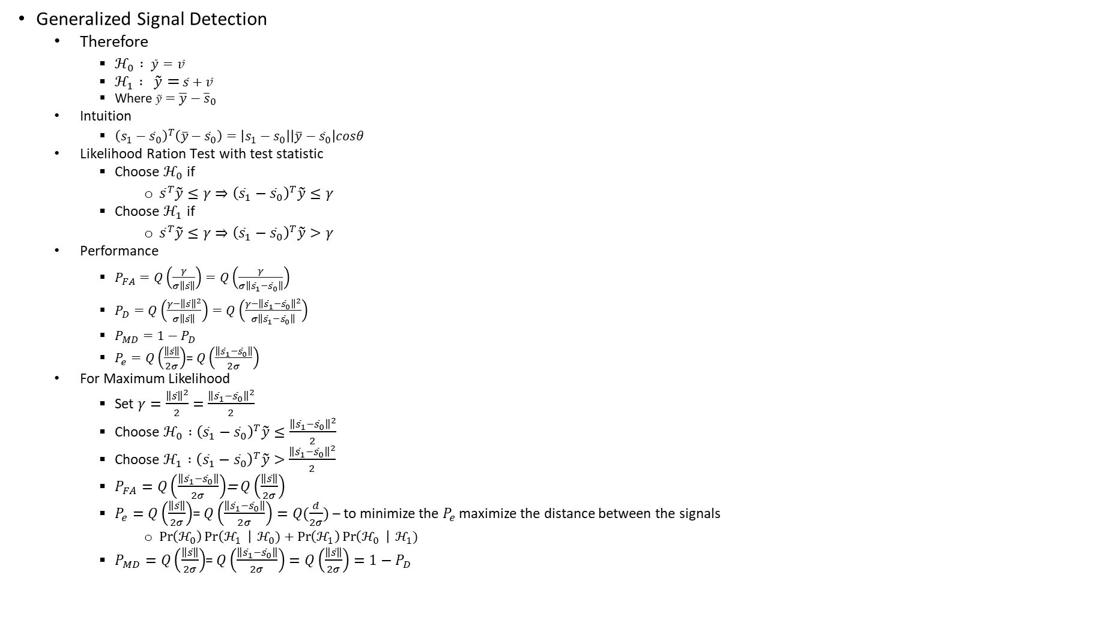
Quiz -2 – 31-10-2023
Generalized Signal Detection
  Therefore
    $ℋ_{0} : \tilde{y}=\overline{v}$
    $ℋ_{1} : \tilde{y}=$ $\overline{s}+\overline{v}$
    Where $\tilde{y}=\overline{y}−{\overline{s}}_{0}$
  Intuition
    ${\left(s_{1}−{\overline{s}}_{0}\right)}^{T}\left(\overline{y}−{\overline{s}}_{0}\right)=\left|s_{1}−s_{0}\right|\left|\overline{y}−{\overline{s}}_{0}\right|cosθ$
  L$\text{ikelihood} \text{Ration} \text{Test} \text{with} \text{test} \text{statistic}$
    Choose $ℋ_{0}$ if
      ${\overline{s}}^{T}\tilde{y}≤γ⇒{\left({\overline{s}}_{1}−{\overline{s}}_{0}\right)}^{T}\tilde{y}≤γ$
    Choose $ℋ_{1}$ if
      ${\overline{s}}^{T}\tilde{y}≤γ⇒{\left({\overline{s}}_{1}−{\overline{s}}_{0}\right)}^{T}\tilde{y}>γ$
  Performance
    $P_{FA}=Q\left(\frac{γ}{σ\left\|\overline{s}\right\|}\right)=Q\left(\frac{γ}{σ\left\|{\overline{s}}_{1}−{\overline{s}}_{0}\right\|}\right)$
    $P_{D}=Q\left(\frac{γ−{\left\|\overline{s}\right\|}^{2}}{σ\left\|\overline{s}\right\|}\right)=Q\left(\frac{γ−{\left\|{\overline{s}}_{1}−{\overline{s}}_{0}\right\|}^{2}}{σ\left\|{\overline{s}}_{1}−{\overline{s}}_{0}\right\|}\right)$
    $P_{MD}=1−P_{D}$
    $P_{e}=Q\left(\frac{\left\|\overline{s}\right\|}{2σ}\right)$= $Q\left(\frac{\left\|{\overline{s}}_{1}−{\overline{s}}_{0}\right\|}{2σ}\right)$
  For Maximum Likelihood
    Set $γ=\frac{{\left\|\overline{s}\right\|}^{2}}{2}=\frac{{\left\|{\overline{s}}_{1}−{\overline{s}}_{0}\right\|}^{2}}{2}$
    Choose $ℋ_{0} :{\left({\overline{s}}_{1}−{\overline{s}}_{0}\right)}^{T}\tilde{y}≤\frac{{\left\|{\overline{s}}_{1}−{\overline{s}}_{0}\right\|}^{2}}{2}$
    Choose $ℋ_{1} :{\left({\overline{s}}_{1}−{\overline{s}}_{0}\right)}^{T}\tilde{y}>\frac{{\left\|{\overline{s}}_{1}−{\overline{s}}_{0}\right\|}^{2}}{2}$
    $P_{FA}=Q\left(\frac{\left\|{\overline{s}}_{1}−{\overline{s}}_{0}\right\|}{2σ}\right)$= $Q\left(\frac{\left\|\overline{s}\right\|}{2σ}\right)$
    $P_{e}=Q\left(\frac{\left\|\overline{s}\right\|}{2σ}\right)$= $Q\left(\frac{\left\|{\overline{s}}_{1}−{\overline{s}}_{0}\right\|}{2σ}\right)=Q(\frac{d}{2σ})$ – to minimize the $P_{e}$ maximize the distance between the signals
      $\operatorname{Pr}\left(ℋ_{0}\right)\operatorname{Pr}\left(ℋ_{1} \right| ℋ_{0})+\operatorname{Pr}\left(ℋ_{1}\right)\operatorname{Pr}\left(ℋ_{0} \right| ℋ_{1})$
    $P_{MD}=Q\left(\frac{\left\|\overline{s}\right\|}{2σ}\right)$= $Q\left(\frac{\left\|{\overline{s}}_{1}−{\overline{s}}_{0}\right\|}{2σ}\right)=Q\left(\frac{\left\|\overline{s}\right\|}{2σ}\right)=1−P_{D}$

Slide 21
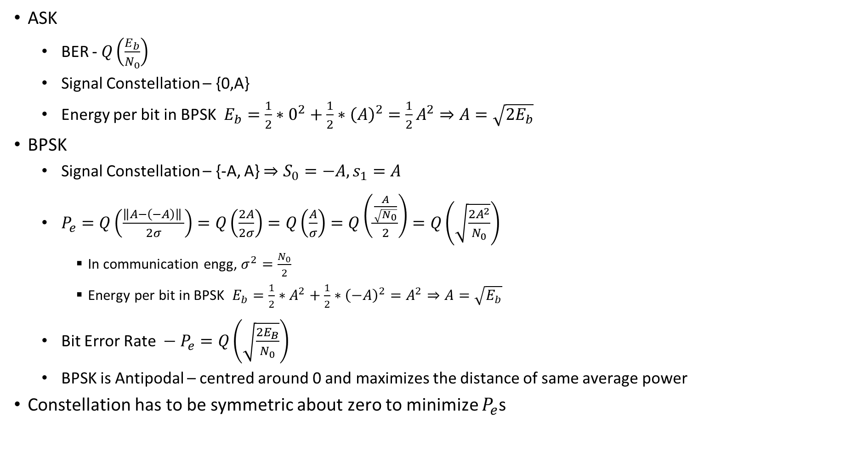
Quiz -2 – 31-10-2023
ASK
  BER - $Q\left(\frac{E_{b}}{N_{0}}\right)$
  Signal Constellation – {0,A}
  Energy per bit in BPSK $E_{b}=\frac{1}{2}∗0^{2}+\frac{1}{2}∗{\left(A\right)}^{2}={\frac{1}{2}A}^{2}⇒A=\sqrt{2E_{b}}$
BPSK
  Signal Constellation – {-A, A} $⇒S_{0}=−A, s_{1}=A$
  $P_{e}=Q\left(\frac{{\left\|A−\left(−A\right)\right\|}^{ }}{2σ}\right)=Q\left(\frac{2A}{2σ}\right)=Q\left(\frac{A}{σ}\right)=Q\left(\frac{\frac{A}{\sqrt{N_{0}}}}{2}\right)=Q\left(\sqrt{\frac{2A^{2}}{N_{0}}}\right)$
    In communication engg, $σ^{2}=\frac{N_{0}}{2}$
    Energy per bit in BPSK $E_{b}=\frac{1}{2}∗A^{2}+\frac{1}{2}∗{\left(−A\right)}^{2}=A^{2}⇒A=\sqrt{E_{b}}$
  Bit Error Rate $− P_{e}=Q\left(\sqrt{\frac{2E_{B}}{N_{0}}}\right)$
  BPSK is Antipodal – centred around 0 and maximizes the distance of same average power
Constellation has to be symmetric about zero to minimize $P_{e}$s

Slide 22
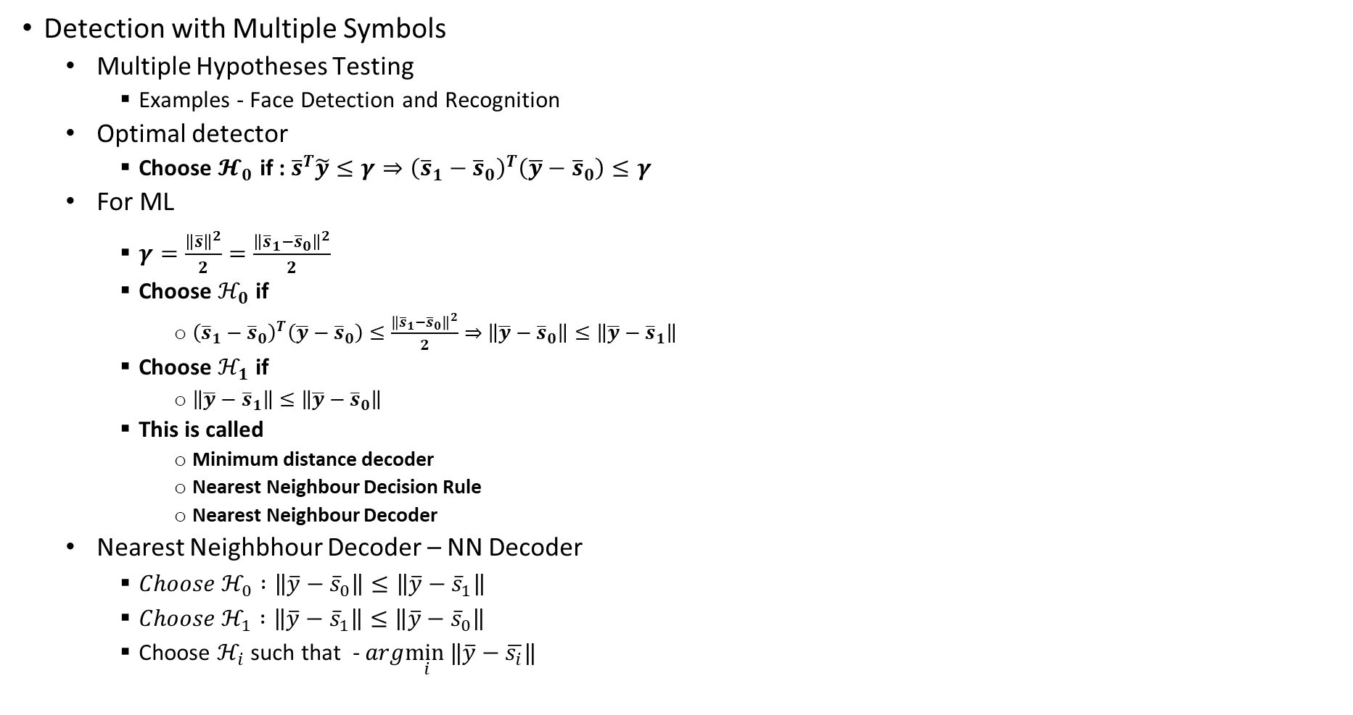
Quiz -2 – 31-10-2023
Detection with Multiple Symbols
  Multiple Hypotheses Testing
    Examples - Face Detection and Recognition
  Optimal detector
    Choose $𝓗_{0}$ if : ${\overline{s}}^{T}\tilde{y}≤γ⇒{\left({\overline{s}}_{1}−{\overline{s}}_{0}\right)}^{T}\left(\overline{y}−{\overline{s}}_{0}\right)≤γ$
  For ML
    $γ=\frac{{\left\|\overline{s}\right\|}^{2}}{2}=\frac{{\left\|{\overline{s}}_{1}−{\overline{s}}_{0}\right\|}^{2}}{2}$
    Choose $ℋ_{0}$ if
      ${\left({\overline{s}}_{1}−{\overline{s}}_{0}\right)}^{T}\left(\overline{y}−{\overline{s}}_{0}\right)≤\frac{{\left\|{\overline{s}}_{1}−{\overline{s}}_{0}\right\|}^{2}}{2}⇒$ $\left\|\overline{y}−{\overline{s}}_{0}\right\|≤\left\|\overline{y}−{\overline{s}}_{1}\right\|$
    Choose $ℋ_{1}$ if
      $\left\|\overline{y}−{\overline{s}}_{1}\right\|≤\left\|\overline{y}−{\overline{s}}_{0}\right\|$
    This is called
      Minimum distance decoder
      Nearest Neighbour Decision Rule
      Nearest Neighbour Decoder
  Nearest Neighbhour Decoder – NN Decoder
    $Choose ℋ_{0} :\left\|\overline{y}−{\overline{s}}_{0}\right\|≤\left\|\overline{y}−{\overline{s}}_{1}\right\|$
    $Choose ℋ_{1} :\left\|\overline{y}−{\overline{s}}_{1}\right\|≤\left\|\overline{y}−{\overline{s}}_{0}\right\|$
    Choose $ℋ_{i}$ such that - $arg\min_{ i}{‖\overline{y}−\overline{s_{i}}‖}$

Slide 23
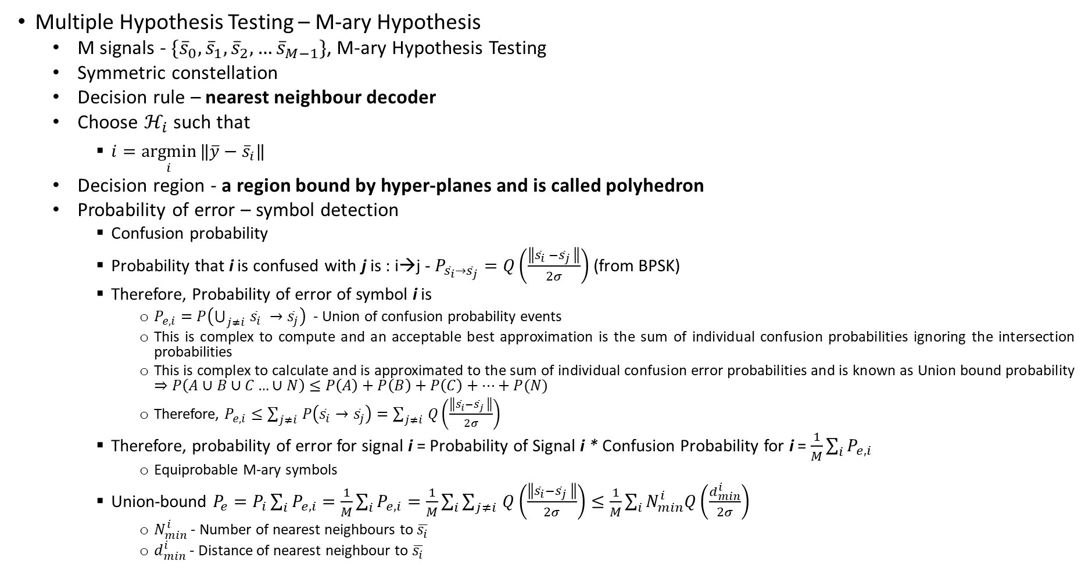
Quiz -2 – 31-10-2023
Multiple Hypothesis Testing – M-ary Hypothesis
  M signals - $\{{\overline{s}}_{0}, {\overline{s}}_{1}, {\overline{s}}_{2},…{\overline{s}}_{M−1}\}$, M-ary Hypothesis Testing
  Symmetric constellation
  Decision rule – nearest neighbour decoder
  Choose $ℋ_{i}$ such that
    $i=\underset{i}{argmin}{‖\overline{y}−{\overline{s}}_{i}‖}$
  Decision region - a region bound by hyper-planes and is called polyhedron
  Probability of error – symbol detection
    Confusion probability
    Probability that i is confused with j is : i→j - $P_{{\overline{s}}_{i}→{\overline{s}}_{j}}=Q\left(\frac{\left\|{\overline{s}}_{i} −{\overline{s}}_{j} \right\|}{2σ}\right)$ (from BPSK)
    Therefore, Probability of error of symbol i is
      $P_{e,i}=P\left(\bigcup_{j≠i }^{ }{{\overline{s}}_{i} →{\overline{s}}_{j}}\right)$ - Union of confusion probability events
      This is complex to compute and an acceptable best approximation is the sum of individual confusion probabilities ignoring the intersection probabilities
      This is complex to calculate and is approximated to the sum of individual confusion error probabilities and is known as Union bound probability $⇒P\left(A∪B∪C…∪N\right)≤P\left(A\right)+P\left(B\right)+P\left(C\right)+…+P(N)$
      Therefore, $P_{e,i}≤\sum_{j≠i }^{ }{P\left({\overline{s}}_{i}→{\overline{s}}_{j}\right)}=\sum_{j≠i }^{ }{Q\left(\frac{\left\|{\overline{s}}_{i}−{\overline{s}}_{j} \right\|}{2σ}\right)}$
    Therefore, probability of error for signal i = Probability of Signal i * Confusion Probability for i = $\frac{1}{M}\sum_{i}^{ }{P_{e,i }}$
      Equiprobable M-ary symbols
    Union-bound $P_{e}=P_{i}\sum_{i}^{ }{P_{e,i}}=\frac{1}{M}\sum_{i}^{ }{P_{e,i}}=\frac{1}{M}\sum_{i}^{ }{\sum_{j≠i }^{ }{Q\left(\frac{\left\|{\overline{s}}_{i}−{\overline{s}}_{j} \right\|}{2σ}\right)}}≤\frac{1}{M}\sum_{i}^{ }{N_{min}^{i}Q\left(\frac{d_{min}^{i}}{2σ}\right) }$
      $N_{min}^{i}$ - Number of nearest neighbours to $\overline{s_{i}}$
      $d_{min}^{i}$ - Distance of nearest neighbour to $\overline{s_{i}}$

Slide 24
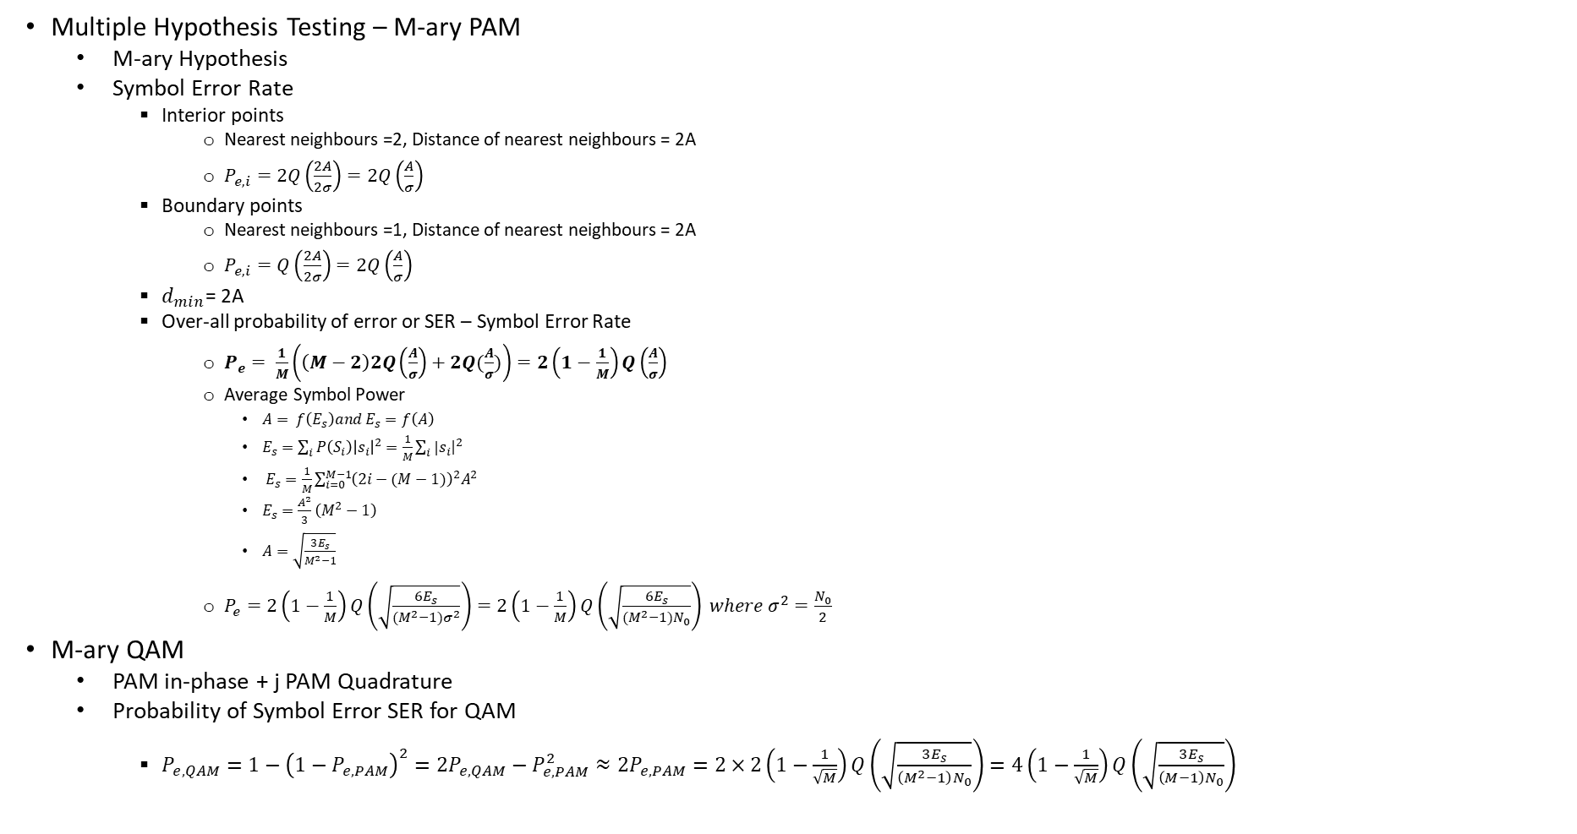
Quiz -2 – 31-10-2023
Multiple Hypothesis Testing – M-ary PAM
  M-ary Hypothesis
  Symbol Error Rate
    Interior points
      Nearest neighbours =2, Distance of nearest neighbours = 2A
      $P_{e,i}=2Q\left(\frac{2A}{2σ}\right)=2Q\left(\frac{A}{σ}\right)$
    Boundary points
      Nearest neighbours =1, Distance of nearest neighbours = 2A
      $P_{e,i}=Q\left(\frac{2A}{2σ}\right)=2Q\left(\frac{A}{σ}\right)$
    $d_{min}$= 2A
    Over-all probability of error or SER – Symbol Error Rate
      $P_{e}= \frac{1}{M}\left(\left(M−2\right)2Q\left(\frac{A}{σ}\right)+2Q(\frac{A}{σ})\right)=2\left(1−\frac{1}{M}\right)Q\left(\frac{A}{σ}\right)$
      Average Symbol Power
        $A= f\left(E_{s}\right)and E_{s}=f\left(A\right)$
        $E_{s}=\sum_{i}^{ }{P\left(S_{i}\right){\left|s_{i}\right|}^{2}=\frac{1}{M}}\sum_{i}^{ }{|s_{i}{\left.​\right|}^{2} }$
        $E_{s}=\frac{1}{M}\sum_{i=0}^{M−1}{{\left(2i−(M−1)\right)}^{2}A^{2}}$
        $E_{s}=\frac{A^{2}}{3}\left(M^{2}−1\right)$
        $A=\sqrt{\frac{3E_{s}}{M^{2}−1}}$
      $P_{e}=2\left(1−\frac{1}{M}\right)Q\left(\sqrt{\frac{6E_{s}}{{(M}^{2}−1)σ^{2}}}\right)=2\left(1−\frac{1}{M}\right)Q\left(\sqrt{\frac{6E_{s}}{{(M}^{2}−1)N_{0}}}\right) where σ^{2}=\frac{N_{0}}{2}$
M-ary QAM
  PAM in-phase + j PAM Quadrature
  Probability of Symbol Error SER for QAM
    $P_{e,QAM}=1−{\left(1−P_{e,PAM}\right)}^{2}=2P_{e,QAM}−P_{e,PAM}^{2}≈2P_{e,PAM}=2×2\left(1−\frac{1}{\sqrt{M}}\right)Q\left(\sqrt{\frac{3E_{s}}{\left(M^{2}−1\right)N_{0}}}\right)=4\left(1−\frac{1}{\sqrt{M}}\right)Q\left(\sqrt{\frac{3E_{s}}{\left(M−1\right)N_{0}}}\right)$

Slide 25
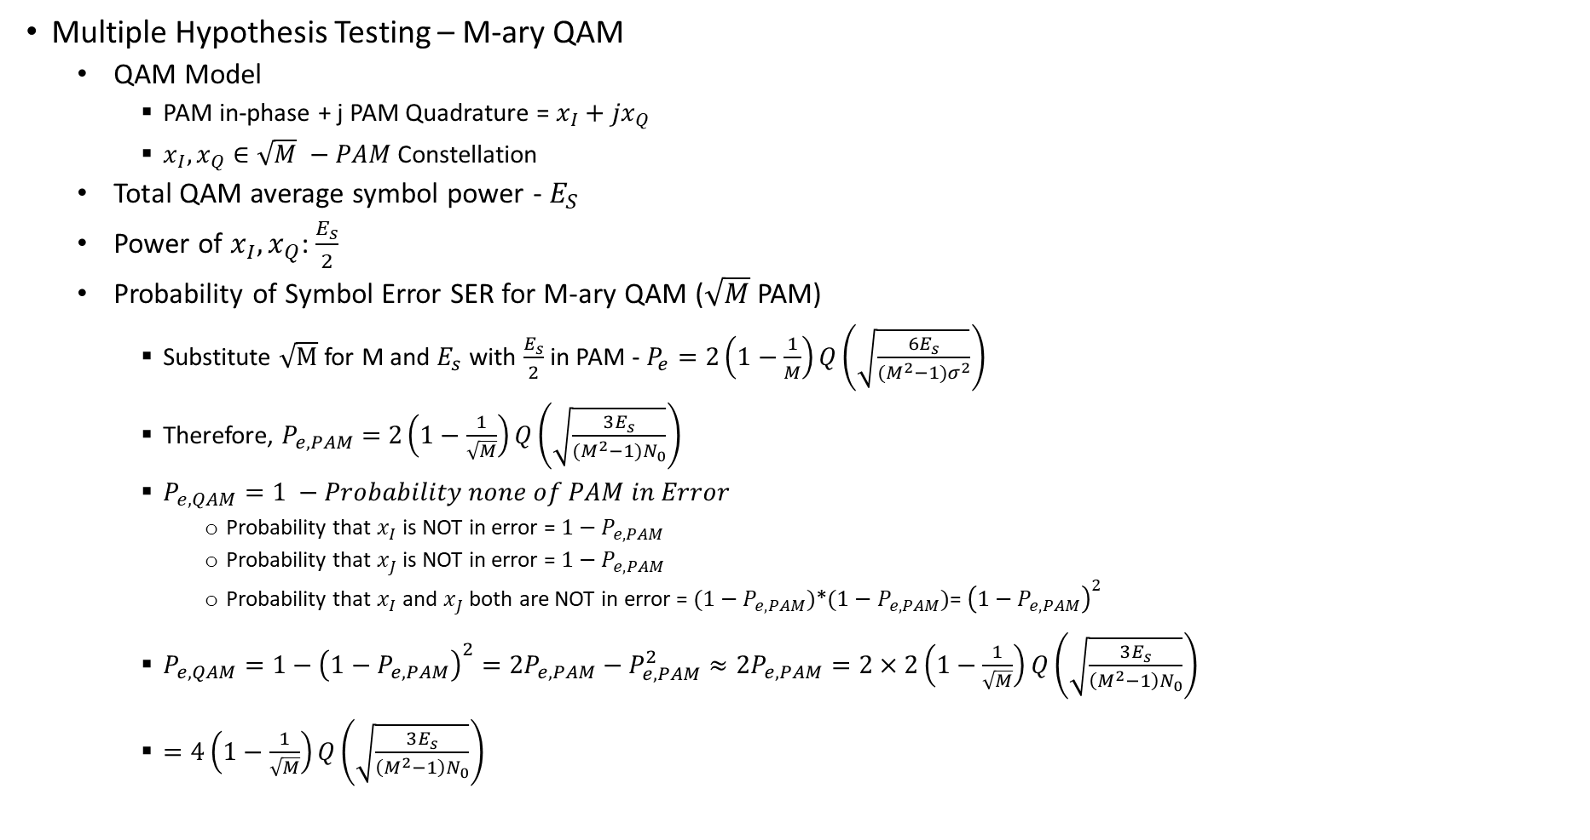
Quiz -2 – 31-10-2023
Multiple Hypothesis Testing – M-ary QAM
  QAM Model
    PAM in-phase + j PAM Quadrature = $x_{I}+jx_{Q}$
    $x_{I},x_{Q}∈\sqrt{M} −PAM$ Constellation
  Total QAM average symbol power - $E_{S}$
  Power of $x_{I},x_{Q}$: $\frac{E_{s}}{2}$
  Probability of Symbol Error SER for M-ary QAM ($\sqrt{M}$ PAM)
    Substitute $\sqrt{M}$ for M and $E_{s}$ with $\frac{E_{s}}{2}$ in PAM - $P_{e}=2\left(1−\frac{1}{M}\right)Q\left(\sqrt{\frac{6E_{s}}{{(M}^{2}−1)σ^{2}}}\right)$
    Therefore, $P_{e,PAM}=$ $2\left(1−\frac{1}{\sqrt{M}}\right)Q\left(\sqrt{\frac{3E_{s}}{{(M}^{2}−1)N_{0}}}\right)$
    $P_{e,QAM}=1 −Probability none of PAM in Error$
      Probability that $x_{I}$ is NOT in error = $1−P_{e,PAM}$
      Probability that $x_{J}$ is NOT in error = $1−P_{e,PAM}$
      Probability that $x_{I}$ and $x_{J}$ both are NOT in error = $(1−P_{e,PAM})$*$(1−P_{e,PAM})$= ${\left(1−P_{e,PAM}\right)}^{2}$
    $P_{e,QAM}=1−{\left(1−P_{e,PAM}\right)}^{2}=2P_{e,PAM}−P_{e,PAM}^{2}≈2P_{e,PAM}=2×2\left(1−\frac{1}{\sqrt{M}}\right)Q\left(\sqrt{\frac{3E_{s}}{\left(M^{2}−1\right)N_{0}}}\right)$
    $=4\left(1−\frac{1}{\sqrt{M}}\right)Q\left(\sqrt{\frac{3E_{s}}{\left(M^{2}−1\right)N_{0}}}\right)$

Slide 26
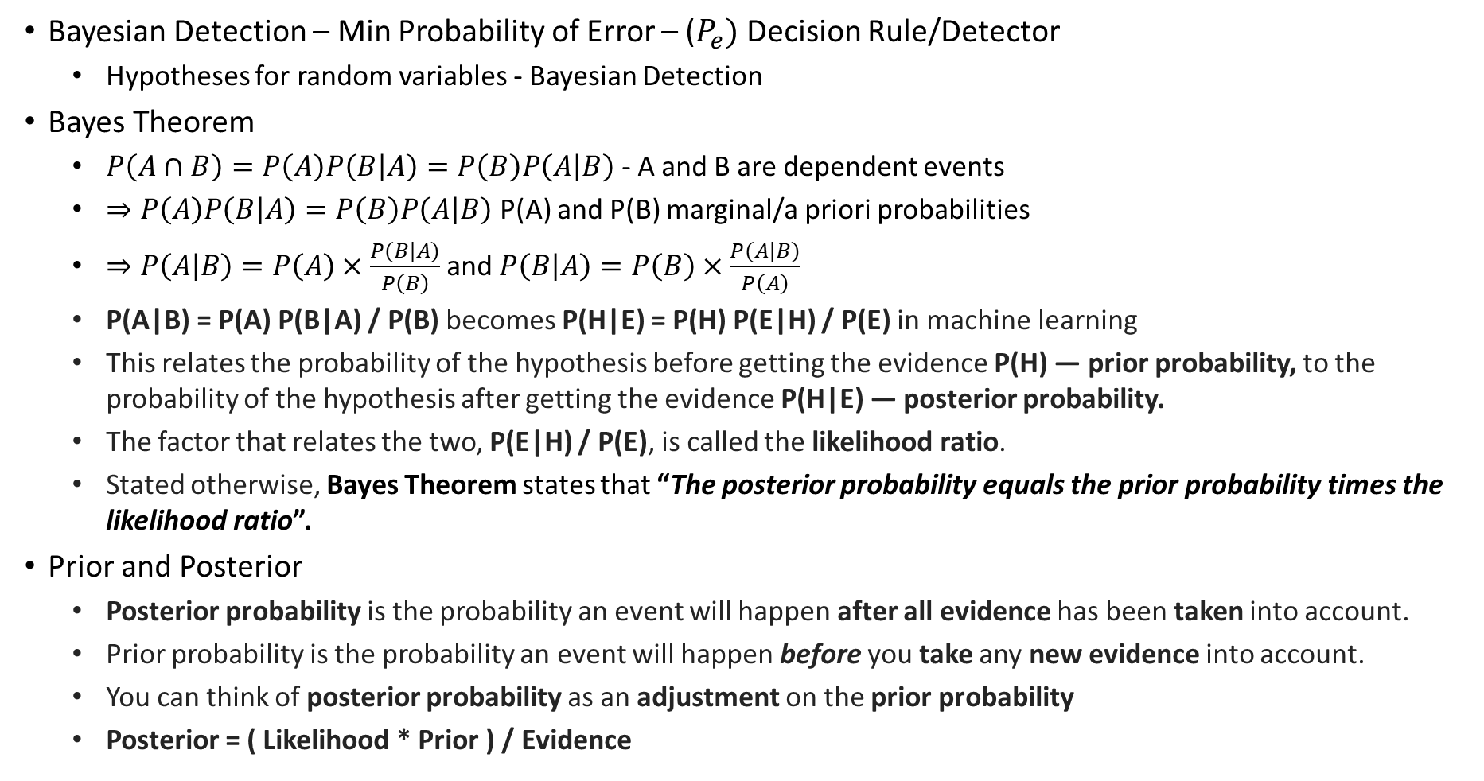
Quiz-3 – 18-11-2023
Bayesian Detection – Min Probability of Error – ($P_{e})$ Decision Rule/Detector
  Hypotheses for random variables - Bayesian Detection
Bayes Theorem
  $P\left(A∩B\right)=P\left(A\right)P\left(B | A\right)=P\left(B\right)P\left(A | B\right)$ - A and B are dependent events
  $⇒P\left(A\right)P\left(B | A\right)=P\left(B\right)P\left(A | B\right)$ P(A) and P(B) marginal/a priori probabilities
  $⇒P\left(A | B\right)=P\left(A\right)×\frac{P(B|A)}{P\left(B\right)}$ and $P\left(B | A\right)=P\left(B\right)×\frac{P(A|B)}{P\left(A\right)}$
  ‌P(A|B) = P(A) P(B|A) / P(B) becomes P(H|E) = P(H) P(E|H) / P(E) in machine learning
  ‌This relates the probability of the hypothesis before getting the evidence P(H) — prior probability, to the probability of the hypothesis after getting the evidence P(H|E) — posterior probability.
  The factor that relates the two, P(E|H) / P(E), is called the likelihood ratio.
  Stated otherwise, Bayes Theorem states that “The posterior probability equals the prior probability times the likelihood ratio”.
Prior and Posterior
  Posterior probability is the probability an event will happen after all evidence has been taken into account.
  Prior probability is the probability an event will happen before you take any new evidence into account.
  You can think of posterior probability as an adjustment on the prior probability
  Posterior = ( Likelihood * Prior ) / Evidence

Slide 27
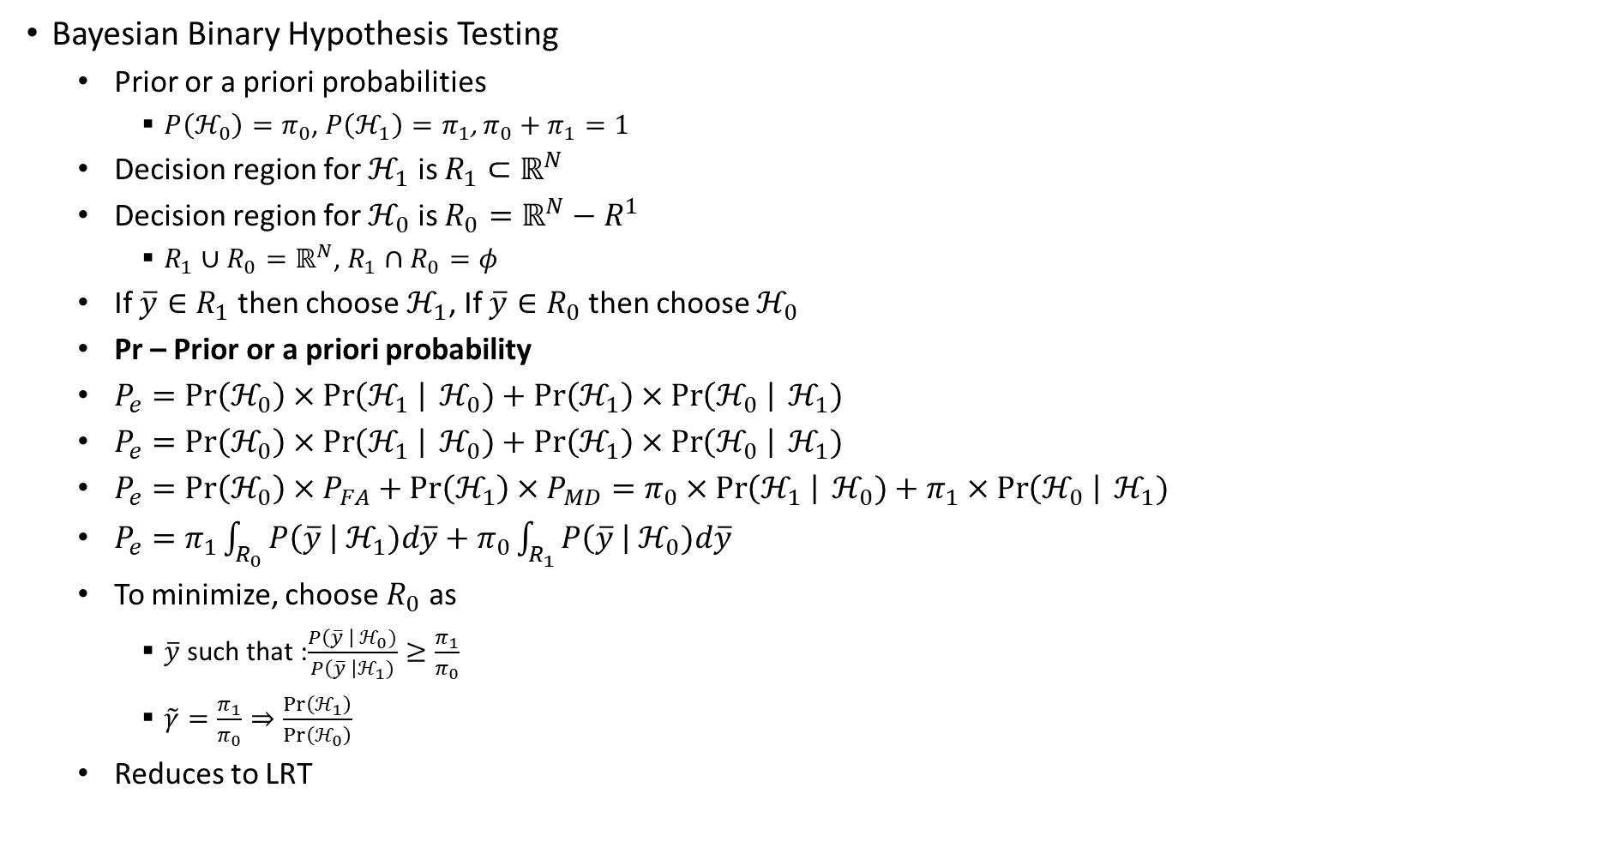
Quiz-3 – 18-11-2023
Bayesian Binary Hypothesis Testing
  Prior or a priori probabilities
    $P\left(ℋ_{0}\right)=π_{0}$, $P\left(ℋ_{1}\right)=π_{1}$, $π_{0}+π_{1}=1$
  Decision region for $ℋ_{1}$ is $R_{1}⊂ℝ^{N}$
  Decision region for $ℋ_{0}$ is $R_{0}=ℝ^{N}−R^{1}$
    $R_{1}∪R_{0}=ℝ^{N}$, $R_{1}∩R_{0}=φ$
  If $\overline{y}∈R_{1}$ then choose $ℋ_{1}$, If $\overline{y}∈R_{0}$ then choose $ℋ_{0}$
  Pr – Prior or a priori probability
  $P_{e}=Pr\left(ℋ_{0}\right)×\operatorname{Pr}\left(ℋ_{1} \right| ℋ_{0})+Pr\left(ℋ_{1}\right)×\operatorname{Pr}\left(ℋ_{0} \right| ℋ_{1})$
  $P_{e}=Pr\left(ℋ_{0}\right)×\operatorname{Pr}\left(ℋ_{1} \right| ℋ_{0})+Pr\left(ℋ_{1}\right)×\operatorname{Pr}\left(ℋ_{0} \right| ℋ_{1})$
  $P_{e}=Pr\left(ℋ_{0}\right)×P_{FA}+Pr\left(ℋ_{1}\right)×P_{MD}=π_{0}×\operatorname{Pr}\left(ℋ_{1} \right| ℋ_{0})+π_{1}×\operatorname{Pr}\left(ℋ_{0} \right| ℋ_{1})$
  $P_{e}=π_{1}\int_{R_{0}}^{ }{P\left(\overline{y} \right| ℋ_{1})d\overline{y}}+π_{0}\int_{R_{1}}^{ }{P\left(\overline{y} \right| ℋ_{0})d\overline{y}}$
  To minimize, choose $R_{0}$ as
    $\overline{y}$ such that :$\frac{P\left(\overline{y} \right| ℋ_{0})}{P\left(\overline{y} \right|ℋ_{1})}≥\frac{π_{1}}{π_{0}}$
    $\tilde{γ}=\frac{π_{1}}{π_{0}}⇒\frac{Pr\left(ℋ_{1}\right)}{\operatorname{Pr}\left(ℋ_{0}\right)}$
  Reduces to LRT

Slide 28
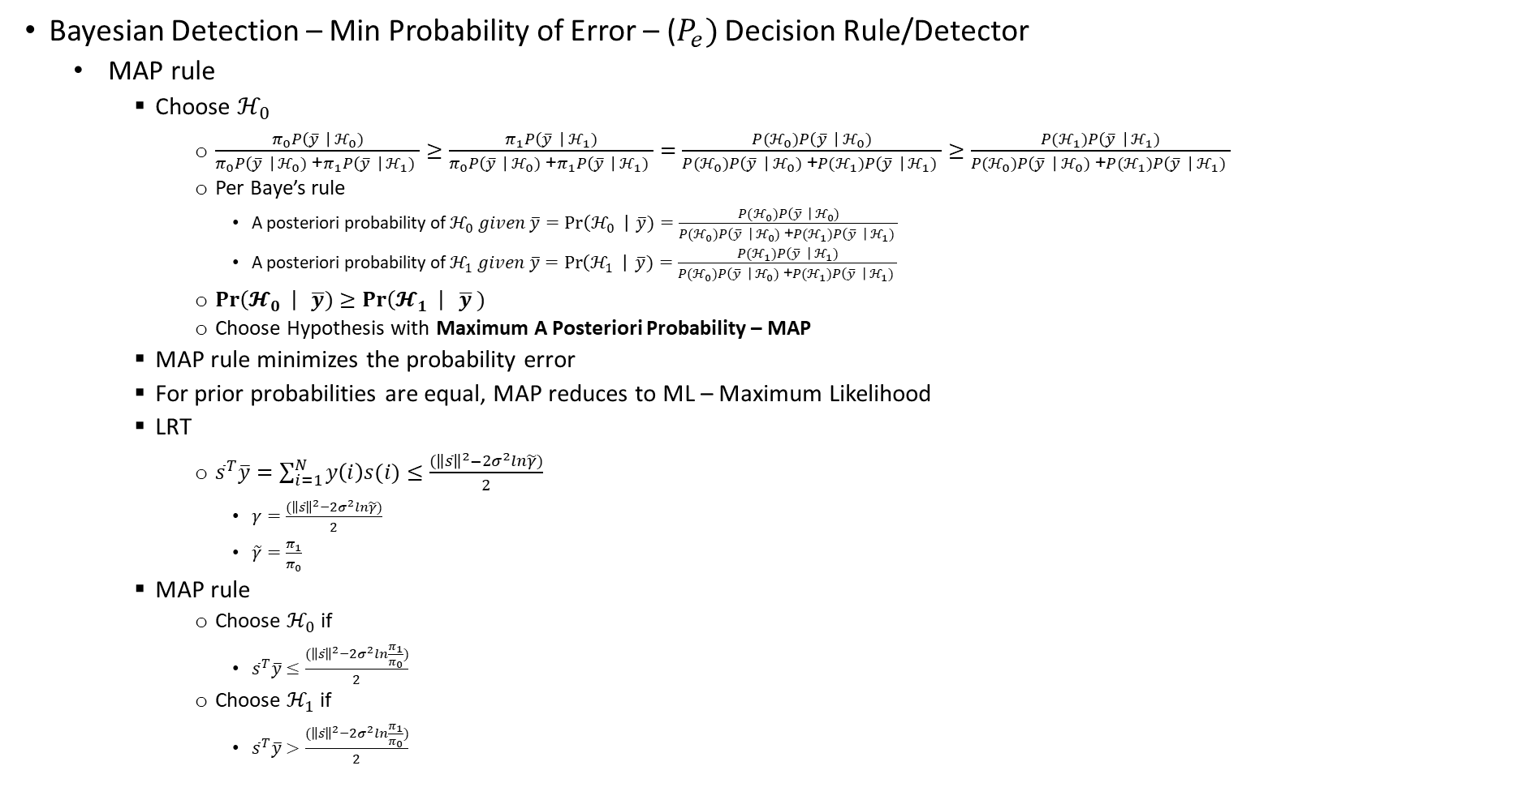
Quiz-3 – 18-11-2023
Bayesian Detection – Min Probability of Error – ($P_{e})$ Decision Rule/Detector
  MAP rule
    Choose $ℋ_{0}$
      $\frac{π_{0}P\left(\overline{y} \right| ℋ_{0})}{π_{0}P\left(\overline{y} \right| ℋ_{0}) \text{+}π_{1}P\left(\overline{y} \right| ℋ_{1}) }≥\frac{π_{1}P\left(\overline{y} \right| ℋ_{1})}{π_{0}P\left(\overline{y} \right| ℋ_{0})\text{ +}π_{1}P\left(\overline{y} \right| ℋ_{1}) }=\frac{P(ℋ_{0})P\left(\overline{y} \right| ℋ_{0})}{P(ℋ_{0})P\left(\overline{y} \right| ℋ_{0})\text{ +}P(ℋ_{1})P\left(\overline{y} \right| ℋ_{1}) }≥\frac{P(ℋ_{1})P\left(\overline{y} \right| ℋ_{1})}{P(ℋ_{0})P\left(\overline{y} \right| ℋ_{0})\text{ +}P(ℋ_{1})P\left(\overline{y} \right| ℋ_{1}) }$
      Per Baye’s rule
        A posteriori probability of $ℋ_{0} given \overline{y}=\operatorname{Pr}\left(ℋ_{0} \right| \overline{y})=\frac{P(ℋ_{0})P\left(\overline{y} \right| ℋ_{0})}{P(ℋ_{0})P\left(\overline{y} \right| ℋ_{0})\text{ +}P(ℋ_{1})P\left(\overline{y} \right| ℋ_{1}) }$
        A posteriori probability of $ℋ_{1} given \overline{y}=\operatorname{Pr}\left(ℋ_{1} \right| \overline{y})=\frac{P(ℋ_{1})P\left(\overline{y} \right| ℋ_{1})}{P(ℋ_{0})P\left(\overline{y} \right| ℋ_{0})\text{ +}P(ℋ_{1})P\left(\overline{y} \right| ℋ_{1}) }$
      $\operatorname{Pr}\left(𝓗_{0} \right| \overline{y})≥\operatorname{Pr}\left(𝓗_{1} \right| \overline{y} )$
      Choose Hypothesis with Maximum A Posteriori Probability – MAP
    MAP rule minimizes the probability error
    For prior probabilities are equal, MAP reduces to ML – Maximum Likelihood
    LRT
      ${\overline{s}}^{T}\overline{y}=\sum_{i=1}^{N}{y\left(i\right)s(i)}≤\frac{{(\left\|\overline{s}\right\|}^{2}−2σ^{2}ln\tilde{γ})}{2}$
        $γ=\frac{{(\left\|\overline{s}\right\|}^{2}−2σ^{2}ln\tilde{γ})}{2}$
        $\tilde{γ}=\frac{π_{1}}{π_{0}}$
    MAP rule
      Choose $ℋ_{0}$ if
        ${\overline{s}}^{T}\overline{y}≤\frac{{(\left\|\overline{s}\right\|}^{2}−2σ^{2}ln\frac{π_{1}}{π_{0}})}{2}$
      Choose $ℋ_{1}$ if
        ${\overline{s}}^{T}\overline{y}>\frac{{(\left\|\overline{s}\right\|}^{2}−2σ^{2}ln\frac{π_{1}}{π_{0}})}{2}$

Slide 29
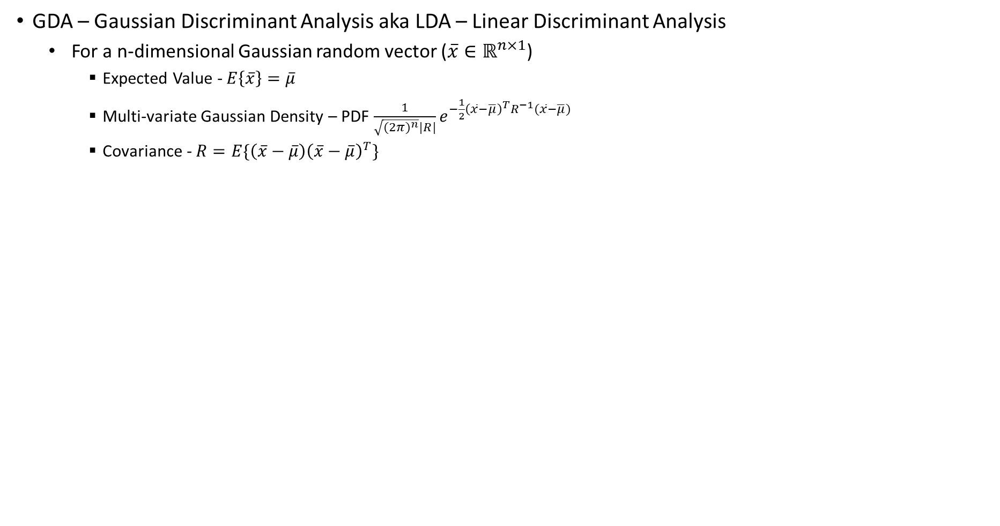
Quiz-3 – 18-11-2023
GDA – Gaussian Discriminant Analysis aka LDA – Linear Discriminant Analysis
  For a n-dimensional Gaussian random vector ($\overline{x}∈ℝ^{n×1}$)
    Expected Value - $E\left\{\overline{x}\right\}=\overline{μ}$
    Multi-variate Gaussian Density – PDF $\frac{1}{\sqrt{({2π)}^{n}}|R|}e^{−\frac{1}{2}{\left(\overline{x}−\overline{μ}\right)}^{T}R^{−1}(\overline{x}−\overline{μ})}$
    Covariance - $R=E\{\left(\overline{x}−\overline{μ}\right){\left(\overline{x}−\overline{μ}\right)}^{T}\}$

Slide 30
Quiz-3
Optimal signals

Slide 31
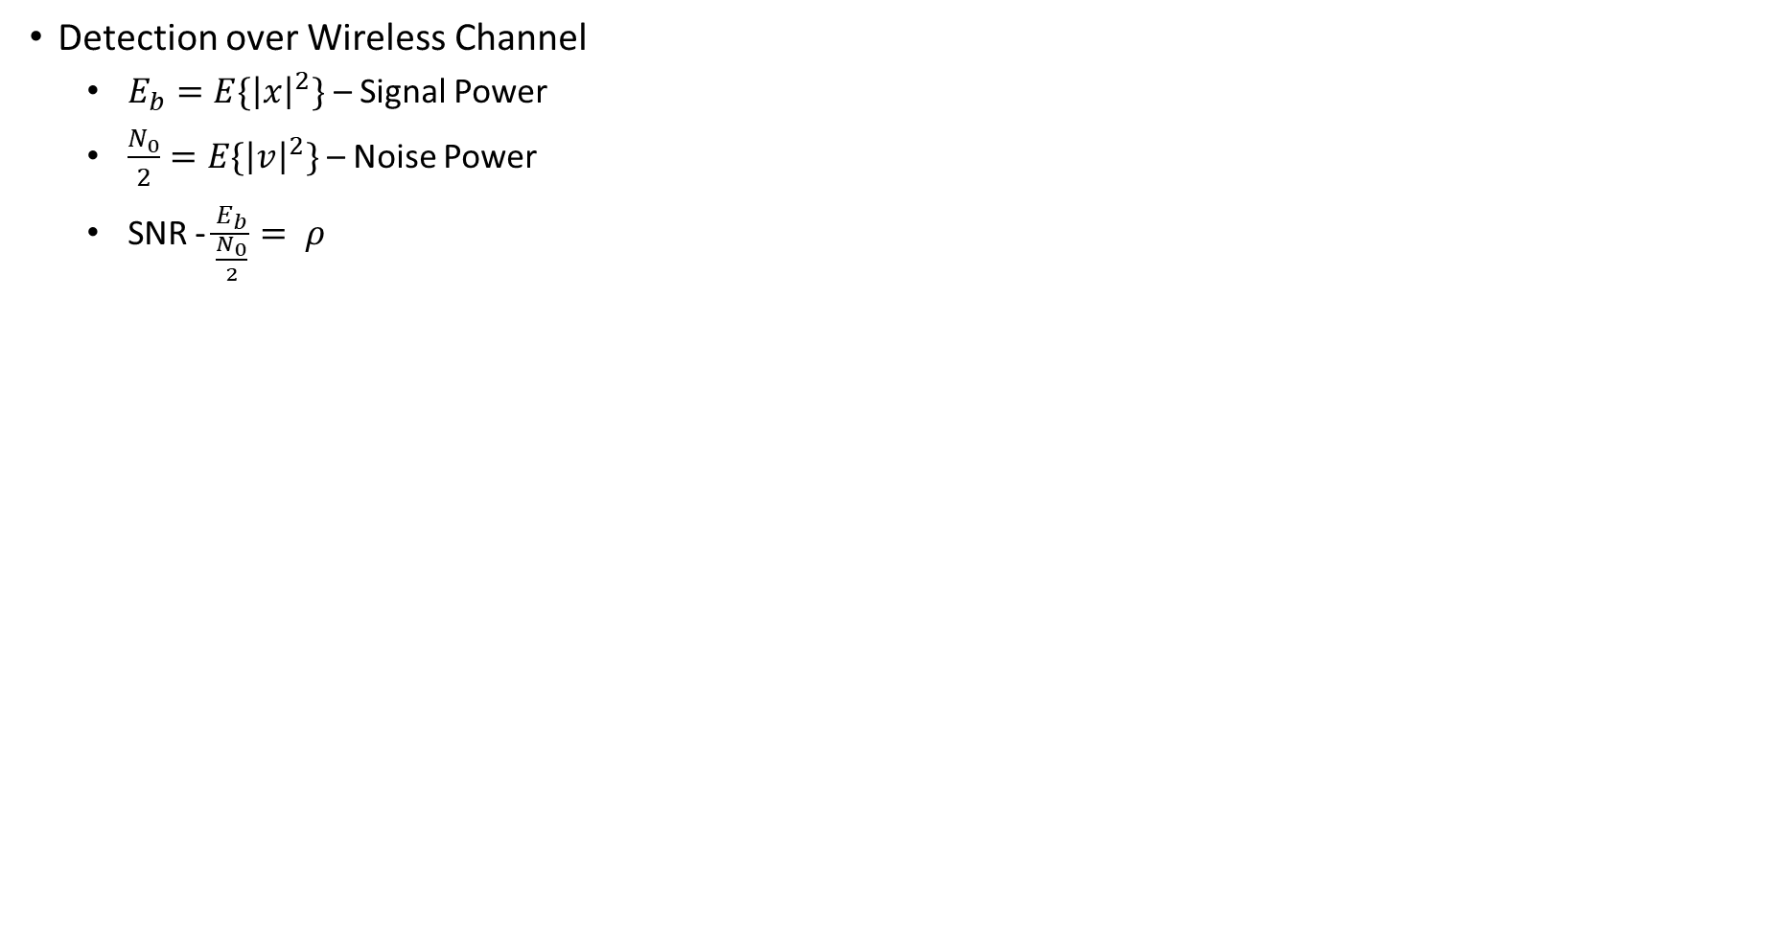
Quiz-3
Detection over Wireless Channel
  $E_{b}=E\{{\left|x\right|}^{2}\}$ – Signal Power
  $\frac{N_{0}}{2}=E\{{\left|v\right|}^{2}\}$ – Noise Power
  SNR - $\frac{E_{b}}{\frac{N_{0}}{2}}= ρ$

Slide 32
Thank you
Brillium Technologies
#501, C Block, Salarpuria Serenity, 5th Main, Sector 7, HSR Layout, Bengaluru 560102, Karnataka, India
Website: www.brillium.in | Email: connect@brillium.in

